Slide 1
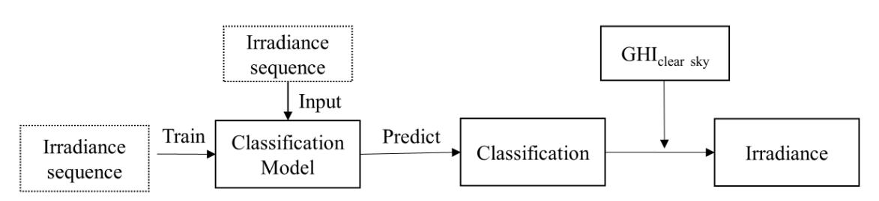
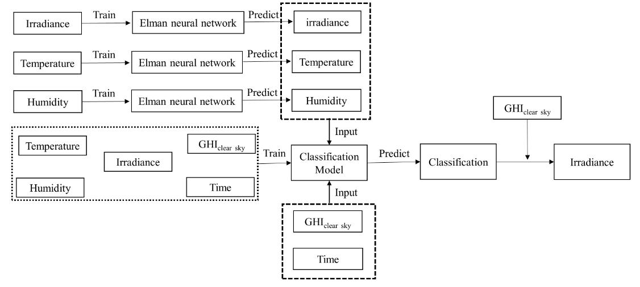
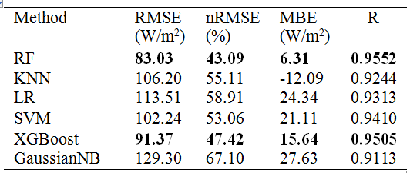
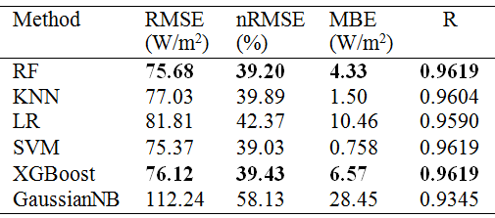
Alternative Energy Sources, Materials & Technologies (AESMT’20)
A novel method based on clear-sky index for solar irradiance forecasting
Xiaoqiao Huang, Yonghang Tai, Junsheng Shi*
Yunnan key lab of opto-electronic information technology, Kunming, Yunnan 650500, China, shijs@ynnu.edu.cn
ABSTRACT
and humidity using Elman neural network is applied to input into the classification model for prediction.
Fig.1. Prediction model based on classification algorithm
Fig.2. Prediction model based on Elman neural network and classification algorithm
Accurate solar irradiance forecasting is important for economy and safety of power systems and quality of the power supply. The traditional machine learning prediction method mostly based on regression predictive modeling. In this paper, a novel method based on classification algorithms for solar irradiance forecasting is proposed. In order to alleviate the complexity and fluctuation of a solar irradiance series, the irradiance series are converted into discrete clear-sky index. Then, the clear-sky index are divided into thirteen classes by a special piecewise function. Six classification algorithms including Gaussian NaiveBayes, k-nearest neighbors, logistic regression, XGBoost, random forest, and support vector machine are used to class according to history solar irradiance and meteorological data. Finally, the result of classification is inversely transformed into the clear-sky index; the predicted value is obtained using multiplying the clear-sky index by the clear-sky irradiance. Experimental results on real-world datasets show that models and algorithms proposed in our thesis can make better prediction accuracy.
1. INTRODUCTION
Solar energy is one of the most important renewable energy sources to meet the energy needs of the world. However, the fluctuation and intermittence of solar irradiance cause variations in PV power output. Solar irradiance forecasting is essential to facilitate planning and managing electricity generation and distribution [1]. A novel method based on classification algorithms for solar irradiance forecasting is proposed in this paper.
3. RESULTS AND DISCUSSION
The root mean square error (RMSE), normalized root mean square error (nRMSE), mean biased error (MBE) and a Pearson correlation coefficient (R) are used to assess the performance of the models. The real-world datasets came from a solar power plant in Denver, Colorado, USA. The forecasted results are shown in Table 1 and 2.
2. METHODS
In this paper, a new machine learning method based on classification algorithms is used. The detailed approach can be seen as follow:
Solar irradiance data classification
Although the irradiance time series is continuous and fluctuant, we can convert it into a series of discrete clear-sky indexes through the clear-sky model.
k=GHI/G_clear (1)
where GHI denotes global horizontal irradiation, G_clear is the GHI under clear-sky conditions calculated with Ineichen mode [3], and k is clear-sky index.
Most values of k are between 0-1.2. Then, rounding numbers to one decimal place and dividing it into thirteen classes by a special piecewise function.
Classification model
Six different machine learning algorithms are used for classification operation:
- Mode 1: Random Forest (RF);
- Mode 2 k-Nearest-Neighbor (KNN);
- Mode 3: Logistic Regression (LR);
- Mode 4 Support Vector Machine (SVM);
- Mode 5: Extreme Gradient Boosting (XGBoost);
- Mode 6 Gaussian Naive Bayes (GaussianNB).
Forecasting methods
The propose forecasting methods include three steps: (1) To obtain the clear-sky index label and train the classification model; (2) To predict the clear-sky index label of the next hour; (3) The predicted value is obtained using multiplying the predicted clear-sky index by the clear-sky irradiance.
Two kinds of structures are designed to predict the clear-sky index. These can be seen in Fig.1and Fig.2.
In Fig.1, only historical irradiance data is used for classification; but in Fig.2, the irradiance, temperature, humidity, CHIclear-sky, and time are used to train classification model, the predicted irradiance, temperature,
Table 1. Statistical results between measured and forecasted irradiance with the method in Fig.1
Table 2. Statistical results between measured and forecasted irradiance with the method in Fig.2
As can be seen in Table 1 and 2, the method with the second structure has better prediction performance. For each structure, the classification methods of Random Forest (RF) and Extreme Gradient Boosting (XGBoost) have good prediction accuracy. Compared with the persistence benchmark model (RMSE=112.59 W/m², nRMSE=58.43 W/m²), the prediction accuracy of the most method is improved. This indicates that the proposed method based on classification algorithms for solar irradiance forecasting is feasible, and when Elman network is added to this simple classification algorithm, the performance will be improved.
4. CONCLUSION
This paper proves that the machine learning model based on the classification algorithm can also be used for irradiance prediction.

