Slide 1
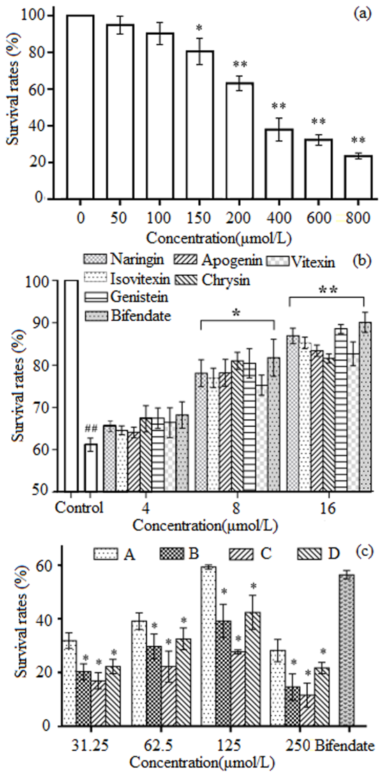
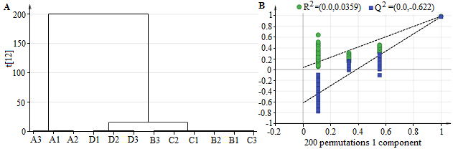
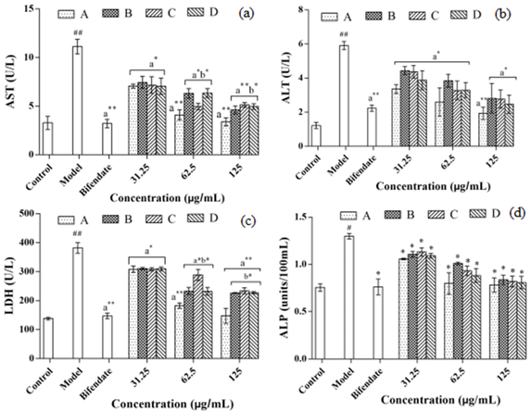
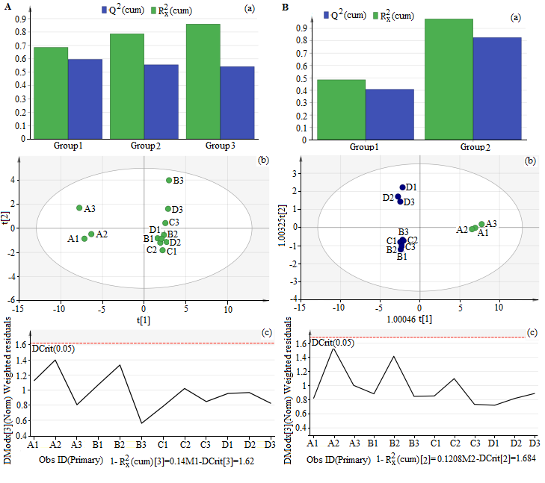
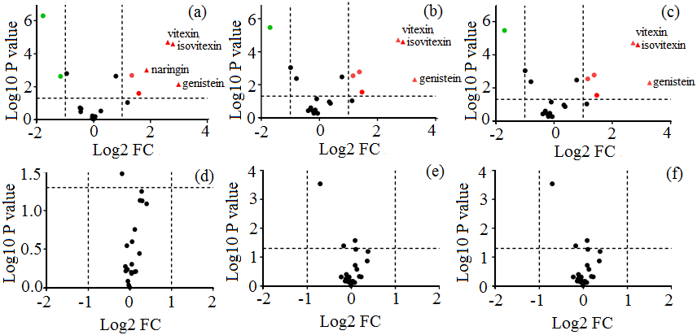
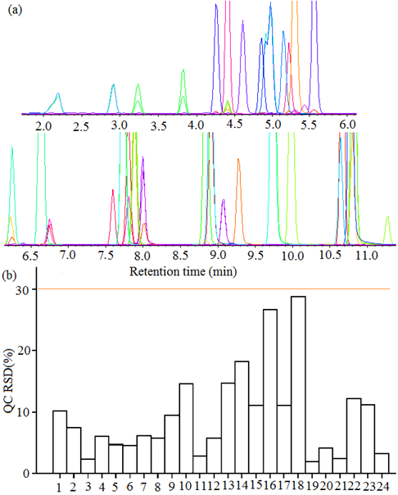
Stronger Antioxidant and Hepatoprotective Components Generated from Rubiaceae Hedyotis diffusa with Biotinidase
in the Field of New Biological Energy Technology
    M.J Zhang 1, Y. Qi 1, X. Chen1, S.Q Niu 1, Y.L.Li1,2*
    1School of Pharmaceutical Science, Shanxi Medical University,Taiyuan 030001, P. R. China, Yun-lan Li: liyunlanrr@163.com
    2 Shanxi university of traditional Chinese medicine 712046, P. R.
Introduction
    Fig.3. PCA and OPLS-DA analysis.
Hedyotis Diffusa is an annual herb, which attributed to the Rubiaceae and mainly distributed in the south of China and some Asian countries, such as Indonesia, Japan, Malaysia [1] and so on. Flavonoids are one kind of the main components of Hedyotis diffusa that exert various pharmacological activities including antioxidant, hepatoprotective and anti-tumor and so on[2-4]. The manufacture technologies of plant flavonoids are mainly divided into traditional and modern extraction technology based on the energy pattern used for industrial applicability and environmental protection[5]. In this research, biological enzymes were used in preparing the total flavonoids of Rubiaceae, Hedyotis diffusa. It has the advantages of low cost, high productive rate, strong specificity and reliability, simple operating equipment and environmental protection, which was suitable for industrial production by using new biological enzymes technology[6]. Compare the total flavonoids and active components of Hedyotis diffusa prepared by enzymatic energy with those prepared by the traditional productive technologies (reflux, ultrasonic method and ultrasound-assisted enzymatic extraction), there were differences in contents and pharmacological antioxidant and hepatoprotective activities remain to be further investigated.
The content of isoflavonoids of flavonoids in biological enzymatic technology was 4.3±0.9 μg/g, which was significantly higher (p<0.05) than that in reflux technology (2.8±0.2μg/g), ultrasonic technology (2.4±0.07μg/g) and ultrasound-assisted enzymatic method (2.6±0.05μg/g). The isoflavonoids had bioactive constituents. So, flavonoids that extracted by biological enzymatic technology had even more stronger biological activities such as anti-tumor, antioxidant, anti-inflammatory than other extraction methods with speculation.
DIFFERENTIAL COMPONENTS ANALYSIS
In order to investigate the differences between four technologies for the preparation of total flavonoids from Hedyotis diffusa, HCA, PCA, OPLS-DA which were general, common and effective, could be used for analysis and the results were shown in Fig.2 and Fig.3. There was a significant difference among biological enzymatic technology and the other extractive techniques including reflux and the ultrasonic methods as shown in Fig.2. And the three sample B(B1~B3), C(C1~ C3) and D(D1~D3) with overlapping in PCA were further separated from score scatter plot of OPLS-DA in two clearly separated regions.
    Fig. 5. Screening for liver protective activities.
The activities of ALT, AST, LDH and ALP in cellular supernatant were tested in order to further investigate the protective effects of total flavonoids of Hedyotis diffusa prepared by different methods on HL-02 cell injury induced by H₂O₂. As shown in Fig.6, At 62.5, 125 μg/mL, the effect of total flavonoids prepared by biological enzymatic technology (sample A) on reduce the content of AST and LDH were significantly higher than those of other three method at same concentrations (p<0.05).
    TOTAL FLAVONOIDS PREPARATION
    The total flavonoids were extracted by biological enzymatic technology(A), reflux technology (B), ultrasonic technology (C) and ultrasound-assisted technology (D). The four extracting technologies were purified by macroporous adsorption resin AB-8.
    UPLC-MS ANALYSIS
    The UPLC-MS methods were used in the determination of total flavonoids, and multivariate statistical analysis were used for composition analysis, such as Hierarchical Clustering Analysis (HCA), Principal Component Analysis (PCA) and Orthogonal Partial Least Squares Discrimination Analysis (OPLS-DA).
    SCREENING FOR LIVER PROTECTIVE ACTIVITY
    The antioxidant activity screening was investigated by H₂O₂-damaged HL-02 cells and used MTT method. And the contents of ALT, AST, LDH and ALP in cell culture medium were measured to investigate the liver protection of total flavonoids of Hedyotis diffusa.
Experiment
    Fig. 2. HCA analysis and permutation test of OPLS-DA.
    Fig. 6. Detections of hepatotoxicity and antioxidant pattern in H₂O₂-induced hepatotoxic HL-O2 cells for 24h.
Conclusions
    DETERMINATION OF FLAVONOID COMPOUND
    In this experiment, the extraction rates, total flavonoids yields, contents of total flavonoids prepared by biological enzymatic technology were significantly higher than those of the other methods. Thirty-six standards were analysed from total flavonoids. The XIC mass chromatograms of the standards were shown in Fig.1(a). It can be seen that each component could be well separated and the peak shape was sharp and symmetrical. Next used QC samples for quality control, the results showed In Fig.1(b). All the dates indicated that the method could identify and quantify different samples with good precision and the experimental dates were stable and reliable. And high correlation coefficient values (R²>0.99) were obtained in this study that show good linearity at a relatively wide range of concentrations.
Results
    Fig.3. PCA and OPLS-DA analysis.
    Volcanic map was drawn for chemical component screening from total flavonoids prepared by four different technologies and the results were shown in Fig.4. Combined with the analysis of the content determined, nine different components were screened out, naringin, vitexin, isovitexin, genistein, luteolin , luteolin-7-O-glucoside, apigenin, chrysin and dihydrokaempferol.
  The contents of isoflavones in the biological enzymatic technology was significantly higher than other three technologies (p<0.05). And nine different components were selected from the total flavonoids prepared by biological enzymatic technology, including, naringin, vitexin, isovitexin, genistein, luteolin, 7-O-glucoside luteolin, apigenin, chrysin and dihydrokaempferol. In conclusion, the innovative biological enzymatic technology could improve the contents of active ingredients (about 3.5 times or more) with hepatoprotective effect, such as apigenin, chrysin, genistein, naringin, vitexin and isovitexin, etc. The total flavonoids prepared by biological enzymatic technology had more effective on antioxidant and hepatoprotective activities. The biological enzymes as new biological energy source could obtain new components with stronger antioxidant and hepatoprotective activities in Hedyotis diffusa, which was beneficial to the development and utilization of biological technology in the field of new energy.
    Fig. 4. Volcano plot.
References
SCREENING FOR LIVER PROTECTIVE ACTIVITY
The results of screening for liver protective activities were shown in Fig.5, indicating that the above six compounds and positive control bifendate all had protective effects on H₂O₂-induced HL-02 cell damage and could improve cell survival rates. And the hepato-protective activity of total flavonoids prepared by enzymatic technology was also significantly higher than those of total flavonoids prepared by other method at the same concentration (p<0.05).
[1] Ye JH, Liu MH, Zhang XL. Chemical profiles and protective effect of hedyotis diffusa Willd in lipopolysaccharide-induced renal inflammation mice. International Journal of Molecular Sciences, 2015, 16(11):27252-27269.
[2] Jiang YN. Research progress on active ingredients and pharmacological effects ofHedyotis diffusa. Renowned Doctor, 2019(03):235.
[3] Wei YH. Research progress of Hedyotis diffusa. Shanxi Journal of Traditional Chinese Medicine, 2018, 34(12):53-56.
[4] Hou SL. Research progress on the chemical constituents and pharmacological activity of TCM medicine. Chinese Journal of Clinical Research, 2018,10(06),140-141.
[5] Wang LL, Bian XY, Gao WN, Li BL, Guo CJ.Advances in extration and purification techniques for flavonoids in plants. Acta Nutrimenta Sinica, 2019,41(06):606-610.
[6] Song LX, Shao JJ. Research progress on extraction methods of flavonoids. Cereals&Oils, 2020, 33(01):21-22.
    Fig. 1. UPLC-MS Determination of Thirty-six Flavonoid Compound.

