Slide 1



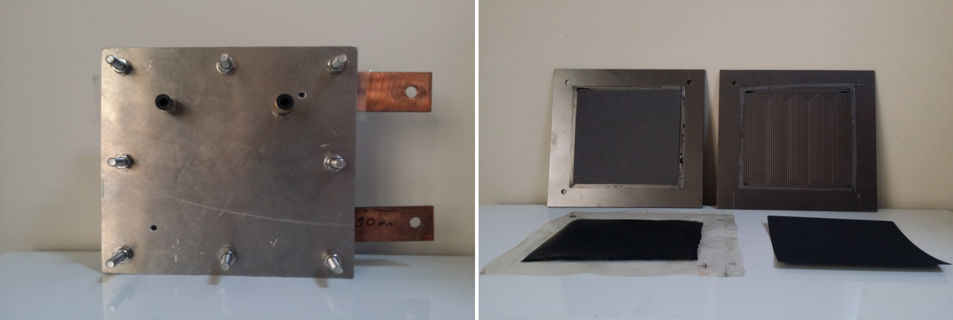
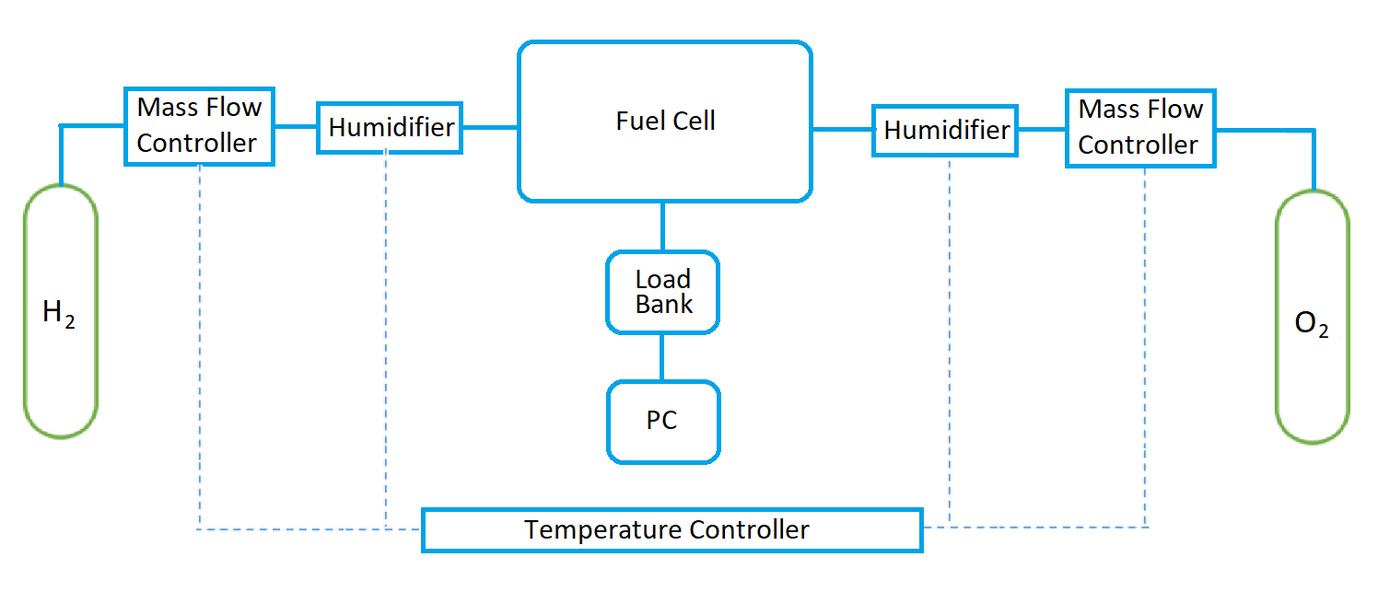

Analysis of Stack Operating Conditions for a Polymer Electrolyte Membrane (PEM) Fuel Cell
K. Saka
Vocational School of Yenişehir İbrahim Orhan, Bursa Uludağ University, Turkey
M. F. Orhan
Department of Mechanical Engineering, American University of Sharjah, UAE
H. Kahraman
Department of Mechanical Engineering, Sakarya University of Applied Sciences, Turkey
Introduction
The oxidant and fuel are tested at various temperatures such as 65ºC, 75ºC and 85ºC. A heating/humidification system by Fuel Cell Technologies, Inc. is used to prepare the reactant gases for the reaction.
The system includes dual temperature controller, including output gas line heaters, on/off bypass valves and sight glass for each humidity bottle. Nafion tubing is inserted into the bottle to provide dew-point humidity level for the gas passage through the tubing.
As explained in detail in the previous sections, the evaporation of water at the operation temperature determines the humidity level of the reactant gases. Higher operation temperatures result in evaporation of more water, which in turn rises the moisture levels of the gases. The overall cell temperature is controlled by the heaters in contact with the end plates and measured by thermocouples installed within the end plates. The heaters and thermocouples are also connected to a temperature control system. The Single Cell Test Protocol by the US Fuel Cell Council is followed in all tests and measurements of voltages, powers, current densities and polarization curves. Before each test, the experimental setup is stabilized keeping the cell at open circuit voltage (OCV) for at least 15 minutes.
The objectives of this study are to analytically model a PEM fuel cell stack and investigate its efficiency. To verify the theoretical model using a PEM fuel cell experimental setup with an active surface area of 100 centimeters square. To examine various operating conditions such as cell temperature, pressure, reactant/product flow rates and humidity affects, and discuss their interrelationships. To also evaluate the stack water management, mass transport phenomenon, ionic and electrical conductivity. Finally, to conduct a parametric study with respect to many operating parameters and improve the overall efficiency. The importance and innovation of this study relay in its unique mathematical model and experimental setup as a case study to help ongoing efforts in the literature for further improvement and commercialization of fuel cells.
Several studies have been presented in the literature regarding the effect of operating conditions on the efficiency of PEM fuel cell[1-7].For instance, Amirinejad et al. [8] have experimentally studied the efficiency of a PEM fuel cell under various operating conditions. They have used dry and humidified hydrogen and oxygen as reactant and oxidant gases on a single PEM fuel cell with an active area of 100 cm². Their results showed that mass transport limitations are very crucial for the efficiency of the PEM fuel cell. It is also stated that the temperature, pressure and humidity of the reactant gases could decrease this limitation and improve the efficiency of the fuel cell.
.
    Fig. 2. PEM Fuel Cell at Several Temperatures
While the majority of PEM fuel cells operate at low temperature ranges, a stationary plant might benefit from a high operating temperature to use excess heat for cogeneration purposes. It is vital to obtain a proper energy and consequently humidity balances for a fuel cell. High temperatures can result in water evaporation within the membrane, which results in dehydration and low proton transport. On the other hand, very low temperatures can cause freezing and again efficiency degradation. This crucial task is especially difficult since the operation temperature of a fuel cell is formed by many parameters such as pressure, humidity and condition of the reactants. Power curves are plotted in Fig. 3.
Analysis
Temperature is an important operational consideration for PEM fuel cells. Rising the temperature decreases the theoretical and reversible efficiency of the cell. Despite this theoretical indication, in reality, rising the temperature improves the fuel cell efficiency. This is due to the fact that at higher temperatures, the mass transfer within the fuel cell increases while the cell resistance drops. Hence, the polarization curve improves.
However, the accumulation of product water in the oxidant stream limits operating temperatures to be below . At this temperature, water boils under 1 atm pressure and its vapour reduces the partial pressure of oxygen in the air. As a result, the cell efficiency drastically decreases due to the oxygen starvation, and can damage the fuel cell and reduce its lifespan. Hence, PEM fuel cells typically operate between 70 and 90.While the operation pressure can be increased to rise the boiling temperature of water, this raises other concerns and must be balanced accordingly in a proper stack design. The effect of the temperature can simply be given by the following Nernst equation,
    Fig. 3. Temperature Effect on Power Curve at Constant Resistance
Conclusions
    Fig. 1. Scheme of the experimental installation.
  The main conclusions drawn from all these work are:
  - The lower operating temperatures provide quick start-up and enhance power density as the need for thermal insulation is reduced.
  - As operating temperature drops, activation losses increase remarkably, humidity and water management are disrupted, and the reaction rate falls.
  - Very low temperatures can cause freezing and again efficiency degradation. In contrast, at high operating temperatures, the water in the anode evaporates quickly and dries it out.
Experimental setup
A single PEM fuel cell setup with an active surface area of 100 cm² is used. The membrane electrode assembly consists of Nafion® HP membrane. Also, AvCarb EP40 gas diffusion layers with 200 µm thicknesses are used. The experimental setup also employs many other components such as SLB-2014 electronic load, two Aalborg DFC-26S-VAL5-C2 mass flow controllers, two humidity bottles, two heated/insulated gas lines, temperature controllers, two pressure regulators and H₂-O₂ tubes. Additionally, backpressures are controlled by backpressure regulators. The polarization curves are obtained by measuring the current values at different voltages, which are controlled by the electronic load bank. The experimental setup includes a computer-based control and data acquisition system, based on a Lab VIEW. The mass flow rates can also be set manually based on the readings through the LCD displays. Furthermore, the cell temperatures are measured constantly by thermocouples installed within the end plates. An experimental setup of a PEM fuel cell with 100cm² active area is demonstrated in Fig. 1.
Results
Fuel cell applications may have different operating conditions based on the system requirements. The common operating temperature range of PEM fuel cells is between 65 and 85°C. The lower operating temperatures provide quick start-up and enhance power density as the need for thermal insulation is reduced. On the other hand, the low operating temperature makes it more difficult to reject heat to the surroundings due to lower temperature differences. Hence, for automotive applications, higher operating temperatures are required for better efficiency. Additionally, higher temperatures also improve tolerance of the fuel cell to impurities such as carbon monoxide. This is especially necessary for any fuel cell operating on hydrocarbon reformates and impure hydrogen. Fig. 2. illustrates an actual polarization curve based on experimental data for a PEM fuel cell at different temperatures.
References
[1] Sridhar P, Perumal R, Rajalakshmi N, Raja M, Dhathathreyan KS. Humidification studies on polymer electrolyte membrane fuel cell. J Power Sources 2001;101(1):72–78.
[2] Wang L, Husar A, Zhout T, Liu H. A parametric study of PEM fuel cell performances. Int J Hydrogen Energy 2003;28(11):1263–72.
[3] Wu SJ, Shiah SW, Yu WL. Parametric analysis of proton exchange membrane fuel cell performance by using the Taguchi method and a neural network. Renew Energy 2009; 34(1):135–44.
[4] Yan WM, Wang XD, Mei SS, Peng XF, Guo YF, Su A. Effects of operating temperatures on performance and pressure drops for a 256 cm² proton exchange membrane fuel cell: An experimental study. J Power Sources 2008;185(2):1040–48.
[5] Saleh MM, Okajima T, Hayase M, Kitamura F, Ohsaka T. Exploring the effects of symmetrical and asymmetrical relative humidity on the performance of H₂/air PEM fuel cell at different temperatures. J Power Sources 2007;164(2):503–09.
[6] Zhang J, Tang Y, Song C, Cheng X, Zhang J, Wang H. PEM fuel cells operated at 0% relative humidity in the temperature range of 23–120 °C. Electrochim Acta 2007;52(15):5095–101.
[7] Hwang JJ, Hwang HS. Parametric studies of a double-cell stack of PEMFC using Grafoil™ flow-field plates. J Power Sources 2002;104(1):24–32.
[8] Amirinejad M, Rowshanzamir S, Eikani MH. Effects of operating parameters on performance of a proton exchange membrane fuel cell. J Power Sources 2006;161(2):872–75.

