Slide 1
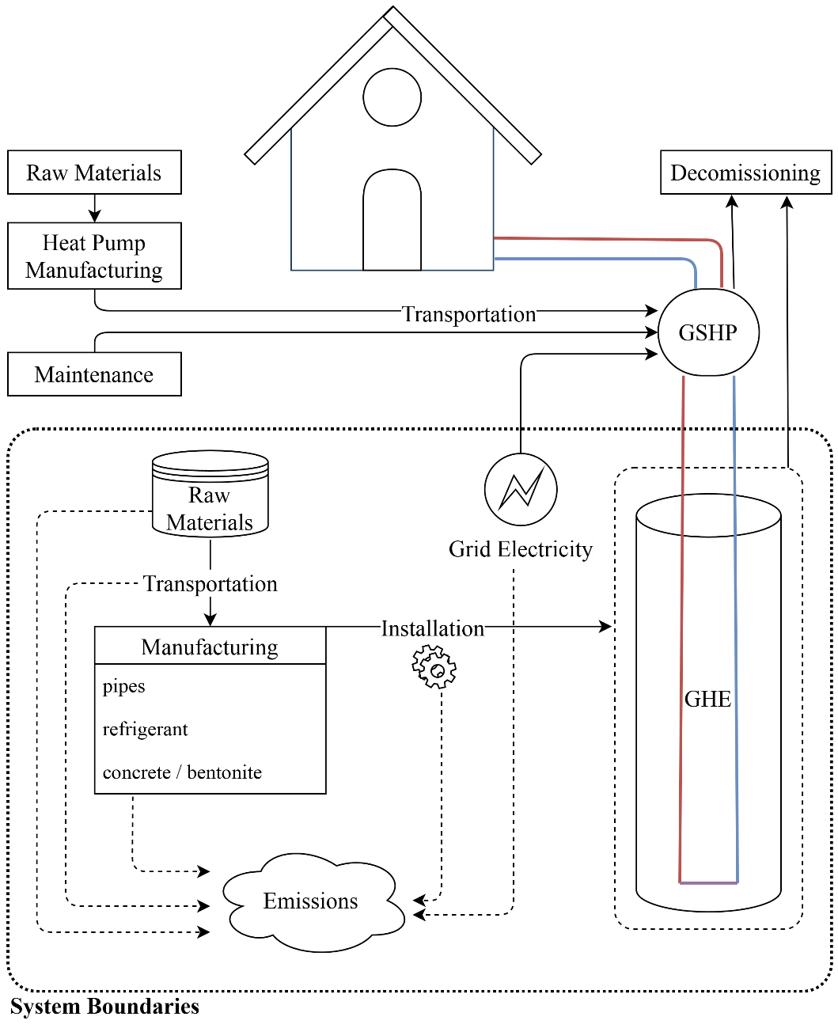
Environmental Impact of a Ground Source Heat Pump system in a Mediterranean residential building – a Preliminary Assessment
Lazaros Aresti, Andreas Skaliontas, Georgios A. Florides, and Paul Christodoulides
Faculty of Engineering and Technology, Cyprus University of Technology, Limassol, Cyprus
Rationale and Summary
Ground Source Heat Pump (GSHP) systems (consisting of ground heat exchangers (GHEs) and HPs) exploit Geothermal Energy (a RES) and are used for space heating and cooling, exhibiting a superior performance than the conventional Air Source Heat Pump (ASHP) systems.
This research focuses on the ecological aspect of GSHP systems, examining a case study in the Mediterranean island of Cyprus to determine the environmental impact of such systems when installed in high- and low-insulated residential buildings.
The GLD software is used to estimate the required GHEs’ parameters for the high and low building’s load.
The Ecoinvent database in combination with the openLCA software is then used to perform the Life Cycle Analysis (LCA) of the system and calculate the environmental impact of both cases.
An ASHP system is set as the baseline for both high and low insulations of a residential building. The GSHP system is compared to the baseline in percentage deviation.
CML2001 method was considered for the Life Cycle Impact Assessment (LCIA) and the Global Warming potential (GWP) (in kg CO2-Eq) was selected as the impact category to estimate.
System boundaries are presented in Figure 2.
Figure 2 . System Boundaries
Results and Discussion
The coaxial configuration required the shallowest borehole (shortest pipe) and the double U-tube the longest pipe for any insulation. (seen in Table 1)
The COP for all GSHP types was estimated at 5.1 and 4.4 for heating and cooling respectively, while the ASHP manufacturer’s COPs were 3.0 and 3.3 respectively.
The results obtained in the GLD software, were incorporated into the openLCA software to estimate the LCIA of the GSHP systems compared to the ASHP system.
The LCIA results are presented in Figure 3 as percentages, where ASHP system is used as baseline (100% = 1). It is evident that in both cases, with the use of high and low insulation, all GSHP systems outperform the ASHP systems.
Introduction
Α Ground Source Heap Pump (GSHP) system, which is also a Renewable Energy System (RES), exchanges heat with the ground, and either extracts or rejects heat with the use Ground Heat Exchangers (GHEs) [1].
The design and configuration of the GHEs for each system depends mainly on the building’s heating and cooling load, the available space and the ground thermal characteristics. discussion on the different design aspects and modelling approaches of GHEs can be found extensively in the literature [2-3].
The use of geothermal energy and GSHP systems has been evaluated to be an environmentally friendly alternative in cases where high heating and cooling loads are observed [4].
Table 1. GHEs characteristics as obtained by GLD software
GHE type | Borehole length (pipe length), m
 | High insulation | Low insulation
Single U-tube | 152.4 | 203.9
Double U-tube | 132.5 (265) | 174.8 (349.6)
Coaxial | 131.9 | 172.8
Materials Production / Processing
Usage / Operation
Distribution / Transportation
reuse
recycle
disposal
End of Life
Figure 1. General Basic flow of LCA
Methodology
In order to examine the environmental impact of a GSHP system, a case study of a residential building in the Mediterranean island of Cyprus is considered.
The selected building has a flat roof and an area of 220 m2, with technical characteristics varing to study high- and low-insulated cases. For the high insulated case, the characteristics determined by the nearly zero energy building (nZEB) EU derivative [5-6] are met.
The yearly heating and cooling loads for the low-insulated case were estimated at 2150 and 21630 kWh respectively, and for the high-insulated case at 530 and 5400 kWh respectively. The heating and cooling peaks were estimated at 8.97 and 11.10 kW for the low-insulated case, and 2.99 and 7.22 kW for the high-insulated case respectively.
The environmental impact of products / processes is assessed with the use of Life Cycle Analysis (LCA), with stages seen in Figure 1. OpenLCA is selected as the tool to perform the LCA, with the Ecoinvent 3.6 database and its methods.
The HPs were assumed to have the same materials and processes used and were neglected from the examined system.
The functional unit (FU) was therefore set as “a unit to satisfy the residential building’s yearly heating and cooling demand”.
The functional unit (FU) was therefore set as “a unit to satisfy the residential building’s yearly heating and cooling demand”.
Figure 3 . LCIA estimations per FU using the CML2001 method for the GWP 20a category.
Conclusions
Preliminary environmental assessment of GSHP systems in a residential building with either high or low insulation.
The GWP impact category was investigated with three vertical types of GHE, which outperform the ASHP system in both cases.
Although these results are favorable for the GSHP systems, a cost comparison and a more detailed environmental assessment should be performed in the future to estimate the overall performance of both systems in every aspect.
References
[1] M. Antics, R. Bertani, and B. Sanner, “Summary of EGC 2013 country update reports on geothermal energy in Europe,” Proc. EGC2013, vol. 3, no. 6, 2013.
[2] L. Aresti, P. Christodoulides, and G. Florides, “A review of the design aspects of ground heat exchangers,” Renew. Sustain. Energy Rev., vol. 92, pp. 757–773, 2018.
[3] P. Christodoulides et al., “Reviewing the Modeling Aspects and Practices of Shallow Geothermal Energy Systems,” Energies, vol. 13, no. 16, p. 4273, Aug. 2020.
[4] L. Aresti, P. Christodoulides, and G. A. Florides, “An investigation on the environmental impact of various Ground Heat Exchangers configurations,” Renew. Energy, vol. 171, pp. 592–605, Jun. 2021.
[5] L. Aresti, P. Christodoulides, G. P. Panayiotou, and G. Florides, “Residential Buildings’ Foundations as a Ground Heat Exchanger and Comparison among Different Types in a Moderate Climate Country,” Energies, vol. 13, no. 23, p. 6287, Nov. 2020.
[6] European Standard, “EN 15459:2006, Energy Efficiency for Buildings — Standard economic evaluation procedure for energy systems in buildings Contents,” 2006.
[7] C. Ministry of Commerce Industry and Energy Tourism, “2nd National plan fo increasing the number of Nearly Zero-Energy Buildings (NZEBs),” 2017.

