Slide 1
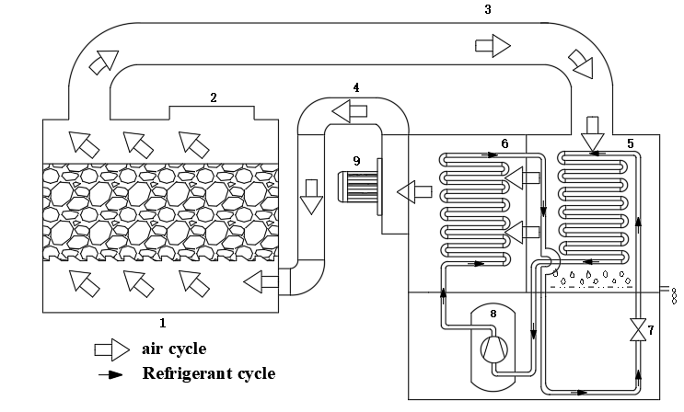
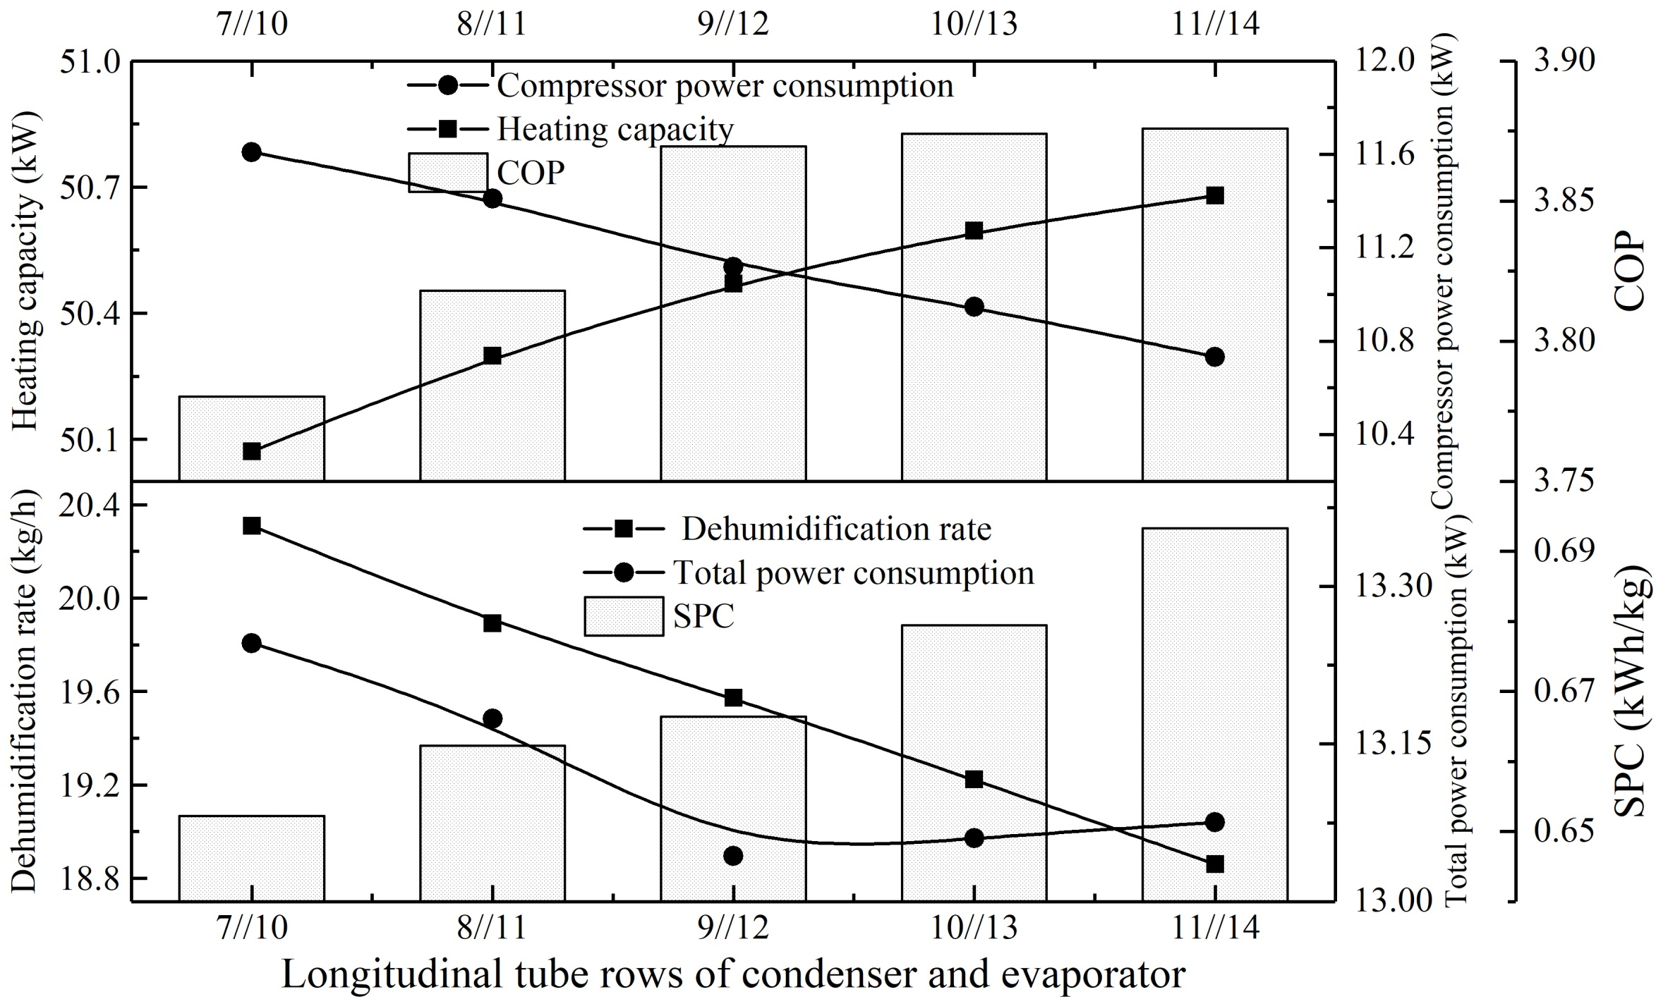
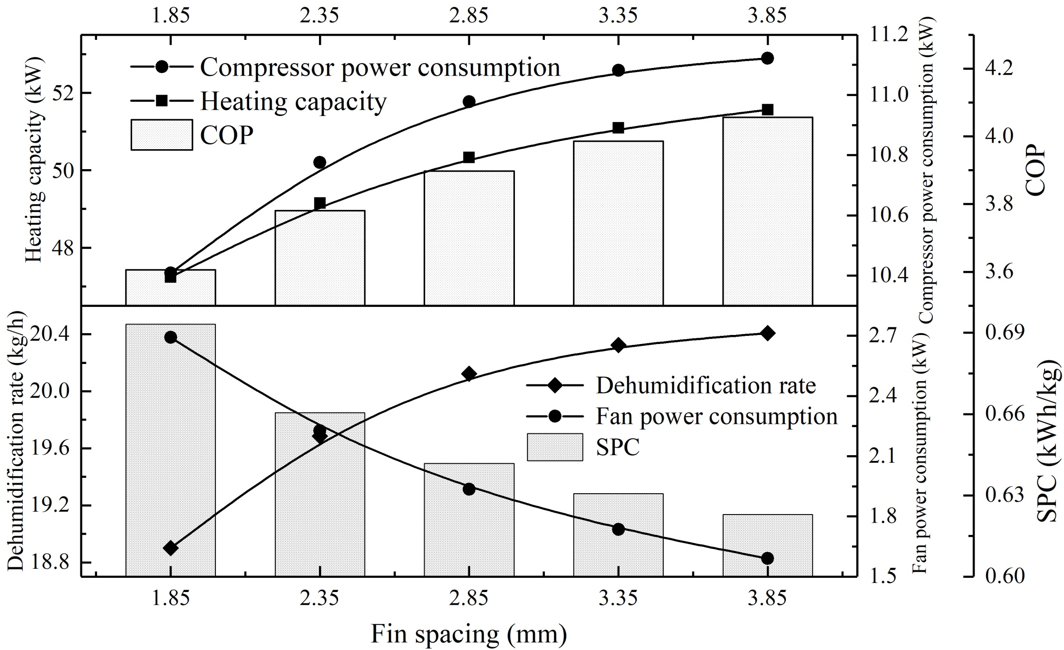
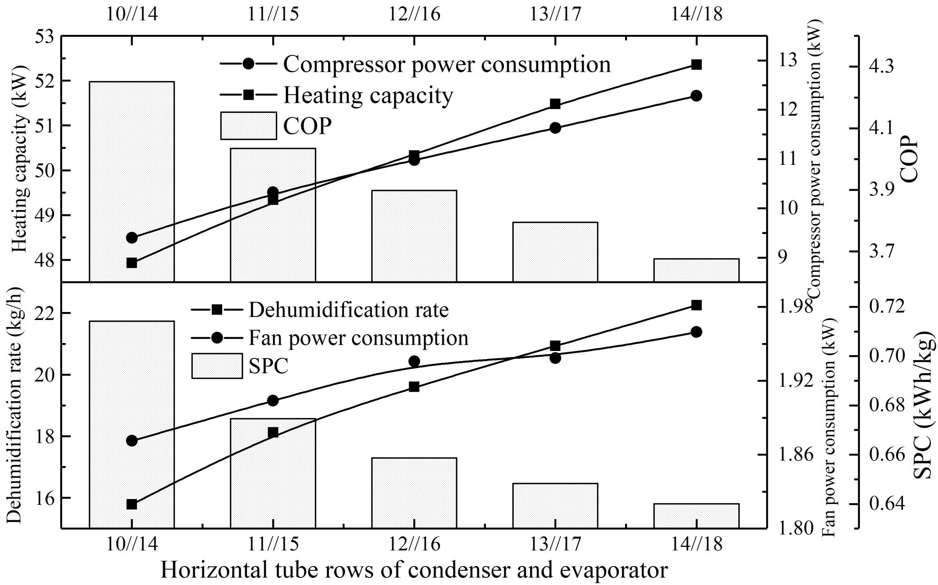
Structural Optimization of Low-Temperature Heat Pump Sludge Drying System
T. Zhang^{1*}, Z. W. Yan¹, J. Y. Cai¹
1 Shanghai University of Electric Power, 2103 Pingliang Road, Shanghai City, P.R.China., taozhang@shiep.edu.cn
Introduction
model of the proposed system can refer to our previous work[6].
OBJECTIVE FUNCTION
In the present study, three performance functions which are coefficient of performance (COP), dehumidification rate(DR) and specific power consumption (SPC) are introduced to evaluate the operating and drying performances of the system. Under the same conditions, the smaller SPC and the higher DR and COP, the better the drying effect.
SPC$=$ $\frac{W_{sys}}{DR}$ (5)
where $W_{sys}$ is the total power consumption of the system, kW.
$COP=\frac{Q_{con}}{W_{sys}}$ (6)
where $Q_{con}$ is the heating capacity, kW.
$DR= m_{a}(d_{a,eva,en}−d_{a,eva,ex})$ (7)
where $m_{a}$ is air mass flow rate, kg/s; $d_{a,eva,en}$、 $d_{a,eva,ex}$ are the moisture content at the inlet and outlet of evaporator respectively, g/kg.
2) Increase the total pressure drop due to the increase in the flow resistance of air, and consequently increases power consumption of the centrifugal fan from 1.87 kW to 1.96 kW; Interaction of above increases the total power consumption of the system from 11.27 kW to 14.24 kW;
3) Decrease the COP from 4.25 to 3.68 due to the big increment of the total power consumption of the system; 4) Increase the dehumidification rate and decrease the SPC. The former increases from 15.78 kg/h to 22.25 kg/h, while the latter decreases slightly from 0.71 kWh/kg to 0.64 kWh/kg, the gradients are 41.00% and 9.86%.
The low-temperature heat pump sludge drying technology has become one of the research hotspots due to its superiorities in energy saving, environmental protection and high operational safety.
The principle of the low-temperature heat pump sludge drying system, which consists of moist air circulation and refrigerant circulation, is shown in Fig. 1. The refrigerant circulation is a heat pump cycle as normal while the moist air circulation is constituted by evaporator, condenser, centrifugal fan, drying closet, and vent tubes.
Sensitivity analysis
Fig. 1. System set-up(1 drying closet;2 feeding inlet;3 return air duct;4 inlet air duct; 5 evaporator; 6 condenser; 7 expansion valve; 8 compressor; 9 centrifugal fan).
Fig. 4. Influence of the number of longitudinal tube rows to the heating capacity, the power consumption of compressor and fan, DR, COP, and SPC
Theoretical model
As shown in Fig.4, increasing the number of longitudinal tube rows would lead to
1) Increase the heating capacity due to the increase of heat transfer area. However, decreasing the refrigerant mass flow rate decreases the compressor power consumption from 11.61 kW to 10.73 kW;
2) Increase the total pressure drop due to the increase in wind speed and consequently increases power consumption of the centrifugal fan from 1.64 kW to 2.34 kW; Interaction of above induces that the total power consumption of the system decreases from 13.25 kW to 13.04 kW and then increases slightly to 13.07 kW;
3) Increase COP from 3.78 to 3.88, with increasing the number of longitudinal tube rows and the increment gradient becomes very small after 9//12.
4) Decrease the dehumidification rate and increase the SPC. The former decreases 20.31 kg/h to 18.86 kg/h, while the latter increases slightly from 0.65 kWh/kg to 0.69 kWh/kg, the gradients are 7.14% and 6.15%.
HEAT AND MASS TRANSFER MODEL
For the two-phase region within the evaporator tube, the heat transfer coefficient ($α_{r,vl,eva}$) between the refrigerant and the tube wall is given as [1]:
$α_{r,vl,eva}=α_{r,l,eva}{\left\{\begin{aligned}{\left[\left(1−x\right)+1.2x^{0.4}(1−x)^{0.01}{\left(\frac{ρ_{r,l,eva}}{ρ_{r,v,eva}}\right)}^{0.37}\right]}^{−2.2} \\ +{\left[\frac{α_{r,v,eva}}{α_{r,l,eva}}x^{0.01}\left(1+8{\left(1−x\right)}^{0.7}{\left(\frac{ρ_{r,l,eva}}{ρ_{r,v,eva}}\right)}^{0.67}\right)\right]}^{−2}\end{aligned}\right\}}^{−0.5}$ (1)
where α_{r,l,eva} and α_{r,v,eva} are respectively the heat transfer coefficients of the gas-phase and the liquid-phase, W/(m²·K); ρ_{r,l,eva} and ρ_{r,v,eva} are respectively the density of the gas-phase and the liquid-phase, kg/m³; x is the dryness of refrigerant.
While in the two-phase region within the condenser tube, the correlative formula that proposed by Shah[2] is adopted to obtain the convective heat transfer coefficient ($α_{r,vl,con}$) between the refrigerant and the tube wall:
$α_{r,vl,con}=α_{r,l,con}\left[(1−x)^{0.8}+\frac{3.8x^{0.76}(1−x)^{0.04}}{{P_{r}}^{0.38}}\right]$ (2)
where α_{r,l,con} is the heat transfer coefficients of the liquid-phase, W/(m²·K); P_{r} is the relative pressure, Pa.
In the evaporator, heat transfer of air is enhanced due to the dehumidification. Therefore, the heat transfer coefficient($α_{a,eva}$) must be modified as [3]:
${ α}_{a,eva}=ξα_{a} η_{s}$ (3)
where α_{a} is the heat transfer coefficients of air in the dry condition, W/(m²·K); $ξ$ is the dehumidification coefficient, -; $η_{s}$ is the surface efficiency of fins, -.
The heat transfer coefficient ($α_{t,dry}$) in the drying closet can be calculated as[4]:
$α_{t,dry}=\left\{\begin{aligned}0.48\frac{λ_{a}}{L_{slu}}{\left(\frac{x_{slu}}{x_{0}}\right)}^{0.95}{{Re}_{a}}^{0.75}{{Pr}_{a}}^{0.33} (x_{slu}≥0.44) \\ 0.1\frac{λ_{a}}{L_{slu}}{{Re}_{a}}^{0.75}{{Pr}_{a}}^{0.33} (x_{slu}<0.44)\end{aligned}\right.$ (4)
where λ_{a} is the heat conductivity of air, W/(m·K); L_{slu} is characteristic length, m; x_{slu}、x₀ are respectively the initial dry base moisture content of sludge and the dry base moisture content of sludge at any time,-; Re_{a}、Pr_{a} are respectively Reynolds number and Prandtl number,-.
Based on the heat transfer coefficient ($α_{m,dry}$) , the mass transfer coefficient accompanied by the heat transfer process can be evaluated as [5]:
${ α}_{m,dry}=\frac{ α_{t,dry}}{ ρ_{a,dry}{Cp}_{a,dry}}{Le}^{−2/3}$ (5)
More details about establishing the theoretical
Fig. 2. Influence of the fin spacing to the heating capacity, the power consumption of compressor and fan, DR, COP, and SPC
As shown in Fig.2, increasing the fin spacing would lead to
1) Increase the heating capacity from 47.23 kW to 51.56 kW result of increasing the heat transfer area, whose increment gradient is 9.17%. Increasing the refrigerant mass flow rate increases the compressor power consumption from 10.41 kW to 11.12 kW;
2) Decrease the total pressure drop due to the decrease in wind speed and consequently decreases power consumption of the centrifugal fan, which is reduced from 2.69 kW to 1.59 kW. It is obvious that the total power consumption of the system decreases from 13.10 kW to 12.71 kW, which comes from the compressor and centrifugal fan;
3) Increase the COP from 3.61 to 4.06 due to the big increment of the heating capacity;
4) Increase the dehumidification rate and decrease the SPC. The former increases from 18.90 kg/h to 20.41 kg/h while the latter decreases slightly from 0.69 kWh/kg to 0.62 kWh/kg, the gradients are 8.00% and 10.14%.
Conclusions
The main conclusion drawn from all these work are：
Combining with increasing COP and decreasing SPC, the fin spacing that is 3.85 mm could enhance the operating performance and drying effect significantly.
Due to the decrease of the COP and SPC and increasing the DR, the number of horizontal tube rows of evaporator and condenser which are respectively set to 18 and 14 is suggested, because it can significantly improve the drying rate and ensure an optimal SPC.
Considering the very limited increase in SPC, the optimal number of longitudinal tube rows of evaporator and condenser with values of 9//12 is suggested due to the big COP under this condition.
References
[1] Cai JY, Ji J, Wang YY, et al. A novel PV/T-air dual source heat pump water heater system: Dynamic simulation and performance characterization. Energy Convers. Manag., 2017; 148: 635-45.
[2] Shah M.M. A general correlation for heat transfer during film condensation inside pipe. Int. J. Heat Mass Transf., 1979; 22: 547-56.
[3] Paksoy, H., Gurbuz, Z., Turgut, B., Dikici, D. and Evliya, H.: Aquifer thermal storage (ATES) for air-conditioning of a supermarket in Turkey. Proceedings of World Renewable Energy Congress-VII 2002, Cologne, Germany, 29 June - 5 July, 2002. 10_n66.pdf.
[4] Deng WS, Yu JL. Simulation analysis on dynamic performance of a combined solar/air dual source heat pump water heater. Energy Convers. Manag., 2016; 120: 378-387.
[5] Białobrzewski I . Determination of the mass transfer coefficient during hot-air-drying of celery root. J Food Eng , 2007; 78: 1388-96.
[6] Zhang T, Yan ZW, Wang LY, et al. Theoretical analysis and experimental study on a low-temperature heat pump sludge drying system. Energy, 2021; 214: 118985.
Fig. 3. Influence of the number of horizontal tube rows to the heating capacity, the power consumption of compressor and fan, DR, COP, and SPC
As shown in Fig.3, increasing the number of horizontal tube rows would lead to
1) Increase the heating capacity result of increasing the heat transfer area, and the flow path of the refrigerant increases with increasing the number of horizontal tube rows, which would inevitably lead to the increase in the compressor power consumption, which increases significantly from 9.40 kW to 12.28 kW ;

