Slide 1
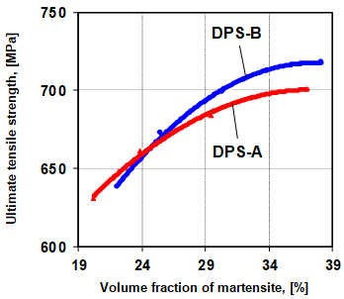
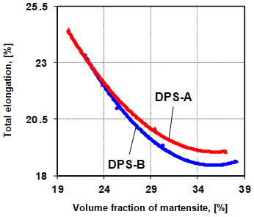
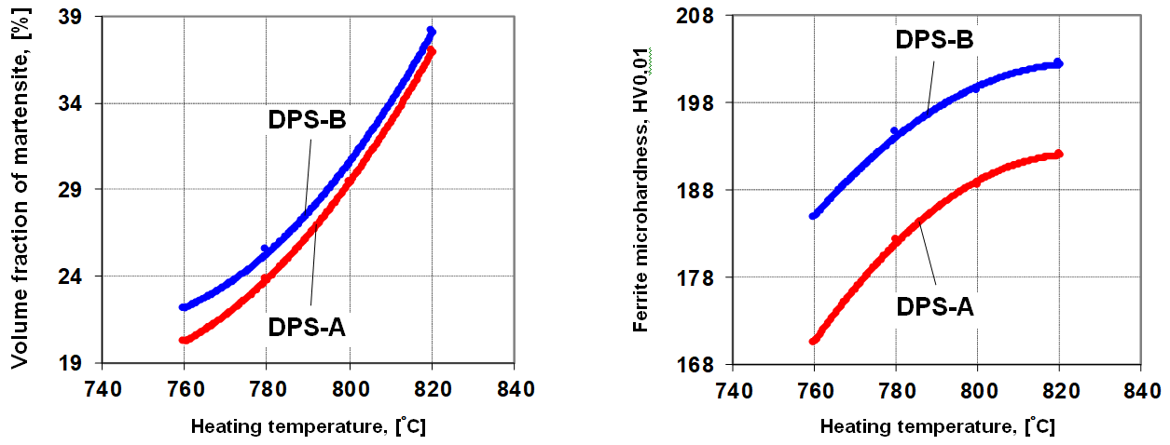
Alternative Energy Sources, Materials & Technologies (AESMT’21)
Dual-phase steels with low manganase content.
Structures and mechanical properties
C. Dulucheanu¹, T.L.Severin^{1, *}, D.A. Cerlinca¹, L. Irimescu¹, J. Javorova²
¹Faculty of Mechanical Engineering, Mechatronics and Management & Research Center MANSiD, University "Stefan cel Mare" of Suceava, 13 Universitatii Street, 720229 – Suceava, Romania, ²University of Chemical Technology and Metallurgy, Bulevard Sveti Kliment Ohridski 8, 1756 Studentski Kompleks, Sofia, Bulgaria
University “Stefan cel Mare” of Suceava, Romania
Introduction
The dual-phase steels are increasingly used by the automotive industry to make structural car body components that can be damaged during an accident. These materials, in general, a percentage of carbon less than 0.12 %, a content of manganese between 1.0 % and 3.5 %, and elements such as V, Cr, Mo, Si, Nb, Ti are to be found in chemical composition in proportions situated below 1%; in recent years, in order to reduce the cars costs, research has also been carried out on steels in which the content of manganese was less than 1 % (0.5 to 1 % Mn). One of the technologies applied to produce these steels is intercritical quenching, the structure and the properties resulting from its application being influenced both by the chemical composition of the alloy and by the technological parameters of heat treatment, [1-3].
In the last years, at the University "Stefan cel Mare" of Suceava, research has been carried out on dual-phase steels with low content of manganese, [3, 4], and in this article are presented results obtained for two such alloys.
have been formed from the austenite obtained by the allotropic transformation of the ferrite. . Raising the heating temperature (T_{Q}), from 760 °C at 780, 800 and 820 °C determined an increase in the volume fraction of austenite that was formed by the allotropic transformation of the ferrite, which generated an increasing volume fraction of martensite that resulted by quenching. In the same time with the rising of the volume fraction of martensite in structures (and decreasing the volume fraction of ferrite), an increase in the size of the martensite islands is observed, as well as a tendency of their connection and the formation of a network around the ferrite grains, [4].
The dates obtained from the tensile testing applied to the intercritical quenched specimens are presented in Tab.2 Figs. 3 and 4, [3].
Experimental details
The chemical compositions of the two studied alloys (denoted DPS-A and DPS-B) were determined with a FOUNDRY-MASTER Xpert Spectrophotometer (Oxford Instruments Analytical GmbH, Germany), they being (wt. %), [3, 4]:
• DPS-A: Fe, 0.087 C, 0.511 Mn, 0.091 Si, 0.0036 P, 0.0039 S, 0.029 Cr, 0.005 Mo, 0.049 Ni, 0.003 Al, 0.082 Cu, 0.003 V, 0.003 W;
DPS-B: Fe, 0.101 C, 0.529 Mn, 0.091 Si, 0.0032 P, 0.0037 S, 0.036 Cr, 0.005 Mo, 0.015 Ni, 0.003 Al, 0.015 Cu, 0.011 Pb, 0.003 V, 0.003 W.
The initial structures of these alloys were composed of 85.30% ferrite and 14.70% pearlite for DPS-A steel, respectively 83.90% ferrite and 16.10% pearlite for DPS-B steel.
In order to obtain ferrite-martensite structure characteristic to dual-phase steels, samples of the two alloys were subjected to intercritical quenching which consisted of heating at to temperatures located between critical points Ac₁ and Ac₃ (T_{Q} - between 760 and 820 °C) and cooling in water with a temperature of 20 °C (without mechanical agitation). After quenching, the samples were subjected to metallographic analyses in order to determine the volume fraction of martensite (V_{M}) in the structures; the analyses were performed with a LEXT OLS4100 Laser Microscope, (Olympus Corporation, Japan) and OLYMPUS Stream MOTION Image Analysis Software.
These analyses were completed by measuring the ferrite microhardness, determinations that were made with a MicroHardness Tester DuraScan 70 (Emco Prüfmaschinen-Test GmbH, Austria), the test load of the Vickers indenter being 0.098 N (0.01 kgf). Five micrographs and five microhardness measurements were performed on each metallographic sample.
In order to determine the influence of heating temperatures (T_{Q}) from the intercritical quenching on mechanical properties, specimens with ferrite-martensite structures obtained by applying the heat treatments described above were subjected to tensile testing, which determined the ultimate tensile strength (R_{m}) and the total elongation (A₅). These tests have been carried out on a QUASAR 600 universal testing machine (Cesare GALDABINI SpA, Italy). Cylindrical specimens with a diameter of 5 mm and initial length between markers (in the calibrated portion) of 25 mm were used.
Table 2. Ultimate tensile strength and total elongation for DPS-A and DPS-B steels
Fig.3. Influence of the volume fraction of martensite on the ultimate tensile strength for DPS-A and DPS-B steels.
Fig.4. Influence of the volume fraction of martensite on the total elongation for DPS-A and DPS-B steels.
The results obtained for the two dual-phase steels with low manganese content (DPS-A and DPS-B) were compared with those determined from previous research (Tab.3, [5]), performed on a dual-phase steel with 1.90% Mn (0.09% C, 1.90% Mn, 0.06% Si, 0.10% Cr, 0.09% Ni, 0.03% Mo, 0.012% Al, 0.15% Cu, 0.019% P, 0.011% S), alloy noted DPS_{1.90Mn} in this article. The higher manganese content determined a lower position of the critical points A_{c1} and A_{c3} (A_{c1} = 703 °C, A_{c3} = 839 °C) compared to the DPS-A and DPS-B alloys and for this reason, the intercritical quenching of DPS_{1.9Mn} steel was performed from temperatures between 740 and 820 °C (compared to 760 – 820 °C for DPS-A and DPS-B alloys).
Table 3. Volume fraction of martensite and mechanical properties for the DPS_{1.90Mn}
There are important differences between the two data sets (Tabs. 1 – 3), differences determined by the very different manganese content of the two categories of steels. In DPS_{1.9Mn} steel, the position of the critical points A_{c1} and A_{c3} led to the obtaining, by intercritical heating, of a higher amount of austenite, which determined the formation, on quenching, of a higher the volume fraction of martensite; thus, for the temperature range 760 – 820 °C, the volume fraction of martensite in the structure was higher by percentages between 22.32 and 41.12%. Because of this, the values of ultimate tensile strength and total elongation at DPS-A and DPS-B steels were much different from those of DPS_{1.90Mn} steel; the total elongation was higher with percentages between 9.28 and 6.98% and the ultimate tensile strength was lower with values between 326 and 434 MPa.
Results and discussion
In a dual-phase steel, the mechanical characteristics are influenced by both the volume fraction of martensite, and the properties of the ferrite, [1, 2]; therefore, in order to analyse the influence of the intercritical heating temperature on the mechanical properties of the DPS-A and DPS-B steels, on samples intercritical quenched, the the volume fraction of martensite (V_{M}) and the ferrite microhardness (HV0.01), were determined, the results being presented in Tab.1, Figs. 1 and 2.
Table 1. Volume fraction of martensite
and ferrite microhardness for DPS-A and DPS-B steels
Conclusions
The increase of the heating temperature in the intercritical range (Ac₁ - Ac₃), between 760 °C and 820 °C, led to the increase of the volume fraction of martensite and the ferrite microhardness in the structures resulting from intercritical quenching; this fact has increased the mechanical strength and reduced the deformability of the dual-phase steels.
The slightly higher carbon and manganese content of DPS-B steel (compared to DPS-A steel) determined the obtaining of slightly higher values of the volume fraction of martensite in the structure, with effect on the ultimate tensile strength and total elongation; the ultimate tensile strength was higher by 7 to 17 MPa, and the total elongation was lower by percentages between 1.17 and 0.45%.
Compared to the mechanical properties of a dual-phase steel with 1.90% Mn (a "classic" dual-phase steel), low manganese steels (0.511% Mn and 0.529% Mn) had much different values of the ultimate tensile strength and total elongation; the ultimate tensile strength was lower by 326 to 434 MPa, and the total elongation was higher by percentages between 9.28 and 6.98%.
Fig.1. Influence of the heating temperature on the volume fraction of martensite for DPS-A and DPS-B steels.
Fig.2. Influence of the heating tempe-rature on the ferrite microhardness for DPS-A and DPS-B steels.
References
[1] M.S. Rashid: Annual Review of Materials Science 11, 245-266 (1981).
[2] S.A. Golovanenko, N.M. Fonshteyn: Metallurghia, 1986.
[3] C. Dulucheanu, T. Severin, A. Potorac, L. Irimescu: Materials Today: Proceedings 19, 3, 941-948 (2019).
[4] C. Dulucheanu, T. Severin: International Multidisciplinary Scientific GeoConference Surveying Geology and Mining Ecology Management, SGEM 17, 63, 85-92 (2017).
[5] C. Dulucheanu, N. Bancescu, T. Severin: Advanced Materials Research 814, 60-67 (2013)
In the structures obtained by quenching from T_{Q} = 760 °C the martensite was in the form of small islands, situated mainly at the boundaries of the ferrite grains. Most of these martensite islands were located in regions where, in initial structure, has been perlite; by heating (over Ac₁) the pearlite was dissolved into austenite, which, through quenching, was transformed in martensite. Through this mechanism has formed a volume fraction of martensite (V_{M}) of approx. 14.70% in the case of DPS-A steel, respectively 16.10% in the case of DPS-A steel, i.e. the equivalent of the volume fraction of pearlite from the original structures. Other martensite islands (the difference up to 20.19% for DPS-A steel, respectively 22.10% for DPS-B steel, Tab.1)

