Slide 1
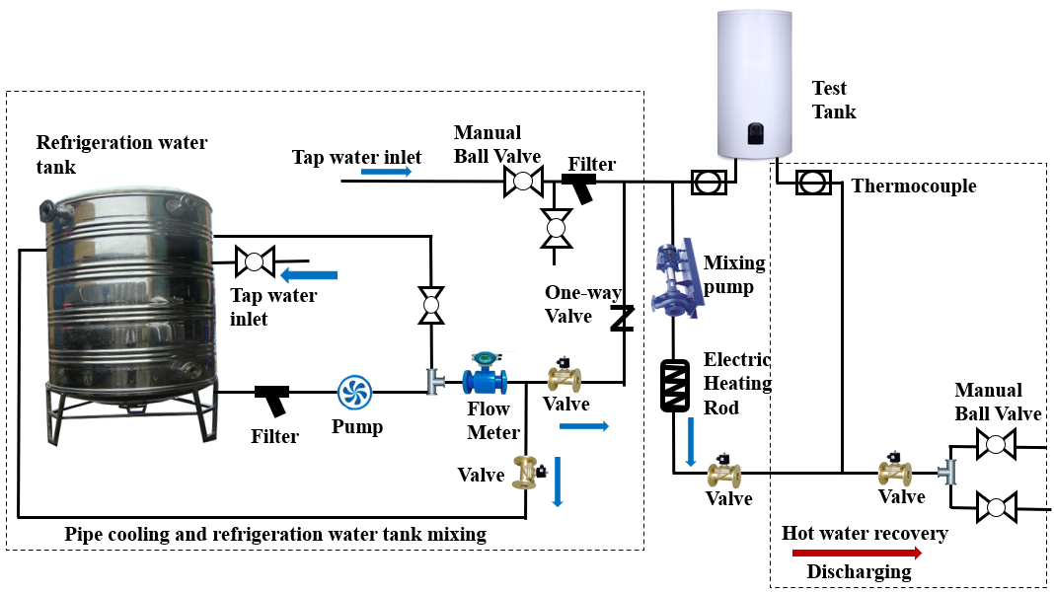
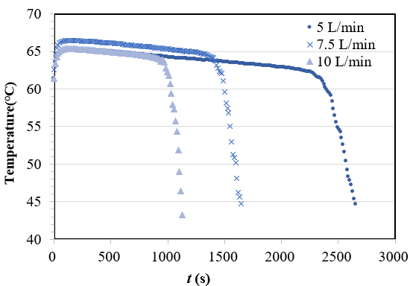
Experimental investigation on the operating parameters of a solar storage tank
Q. Li¹, Y. G. Zhang¹, X. Ding¹, Y. H. Tai^{2*}
¹Solar Energy Research Institute, Yunnan Normal University , Kunming, Yunnan 650500, China
²School of Physics and Electronic Information, Yunnan Normal University, Kunming, Yunnan 650500, China
Introduction
Solar water storage tank is the core component of solar water heating system. It stores the hot water from the solar collector and make it available to users. When the user uses water, cold water enters the water tank, and the heated hot water is discharged for use. Cold water and hot water will be mixed in the water tank, so understanding the actual situation of the hot water storage tank and controlling the mixing of cold water and hot water in use are of practical significance to the utilization level of hot water.
The thermal stratification of solar water storage tanks has been widely studied [1-3]. Scholars have carried out a lot of experimental tests, theoretical analysis and numerical simulation on the thermal stratification of water storage tank in solar water heating system, put forward some methods and parameters to describe the characteristics of thermal stratification and quantify the thermal stratification, and analyzed and discussed the characteristics of thermal stratification from the aspects of operation mode, geometric structure and mixing mechanism. Among them, the operation mode of water tank includes: the incident flow rate of fluid, inlet temperature, initial temperature and other operating conditions.
Output rate of hot water (μ) is an important indicator to quantify the quality of solar hot water storage tanks. It reflects the ratio of actual hot water output to rated capacity, as shown in formula (1). The higher output rate of hot water (μ), the more the water tank can make full use of the heated hot water.
Fig. 2. The water discharge curves of tanks at
different flow rate.
Fig.1. Scheme of the experimental system.
Table 1. Output rate of hot water under different inlet flow rate.
Where, μ - Output rate of hot water, %;
T_{p} - Average temperature of outlet water, ℃;
T_{c-} Average temperature of inlet water, ℃;
T_{i-} Initial water temperature in the tank, ℃;
ρ- The density of water at T_{p}, kg/m³;
m_{p} - the total mass of the drainage, kg;
V - Water tank capacity, L.
Conclusions
In this paper, the solar heat storage tank with mantle heat exchanger was studied. On the solar energy test platform, the inlet and outlet temperature of the mantle solar water tank in the discharging process is tested and analyzed, and the output rate of hot water tank under different inlet flow rate is calculated.
The discharging process of hot water is a dynamic process. When the hot water is taken out and the cold water is used to supplement, the cold water and hot water will be mixed in the same container, which is the key and difficulty to improve the hot water output rate (μ). So how to make the cold water enter, try to reduce the disorder mixing of cold water and hot water, reduce the disturbance of cold water to hot water, but also realize that the hot water in the container can be squeezed out as much as possible when the cold water enters. Further research is needed to improve the hot water output rate (μ) by optimizing the design.
Methodology
Results
In view of the above, the thermal performance of the mantle solar heat storage tank with vertical water inlet and outlet was discussed. In the case of a certain water tank structure, the influence of operating parameters is mainly considered. Taking the output rate of the hot water in the tank as the target value, the non interactive orthogonal test is designed, and the test results are analyzed. The influence of the initial temperature of the water tank, the temperature of the inlet water and the volume flow rate of the inlet water are analyzed, which provides guidance for the system design.
When the initial hot water temperature and inlet water temperature of the tank remain unchanged, the discharge curves at three different flow rates are tested, as shown in Fig.2. From the curve, we can summarize the water discharging process into three stages: (1) High temperature stable stage. When cold water enters the bottom of the water tank, the hot and cold water are mixed to form a thermocline with a certain thickness, which does not affect the hot water at the top of the water tank. Therefore, the hot water is continuously and stably ejected from the water outlet. (2) The temperature drops sharply. The thickness of the thermocline layer changes, and its position gradually develops toward the top of the water tank. When the thermocline touches the top and continues to flow out, the temperature of the water tank shows a sharp downward trend. (3) Low temperature stage. At this time, the hot water in the thermocline layer of the water tank has been almost eliminated, and the outlet water temperature will gradually decrease to the same temperature as the inlet cold water.
Experiment
References
The hot water produced by the water heater system can meet the demand of domestic hot water supply throughout the year, and each part of the system should meet certain design requirements. The test platform used in this experiment is shown in Fig.1. According to the application of hot water in real life, the three influencing factors are taken as follows: the initial hot water temperature of water tank is 55℃, 60℃, 70℃. The inlet water temperature is 10℃, 15℃ and 20℃. The flow rate is 5L/min, 7.5L/min and 10 L/min respectively.
[1] Journals Han Y. M., Wang R. Z., Dai Y. J. Thermal stratification within the water tank. Renewable and Sustainable Energy Reviews 13(5): 1014-1026 (2009).
[2] Journals Fertahi SaïfedDı ̂n., Jamil A., Benbassou A. Review on Solar Thermal Stratified Storage Tanks (STSST): Insight on stratification studies and efficiency indicators. Solar Energy 176: 126-145 (2018).
[3] Journals Chandra Y. P., Matuska T. Stratification analysis of domestic hot water storage tanks: A comprehensive review. Energy and Buildings 187: 110-131 (2019).
It can be seen from table 1 that the output rate of hot water is the highest at low flow rate, followed by medium flow rate and the lowest at high flow rate. The reason is that when the inlet velocity is low, the initial momentum of cold water is small, and it is compatible with hot water.

