Slide 1
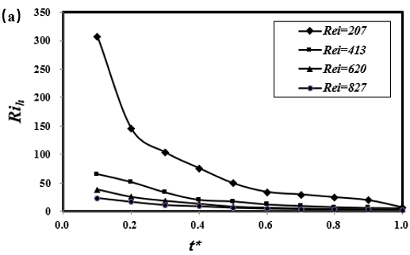
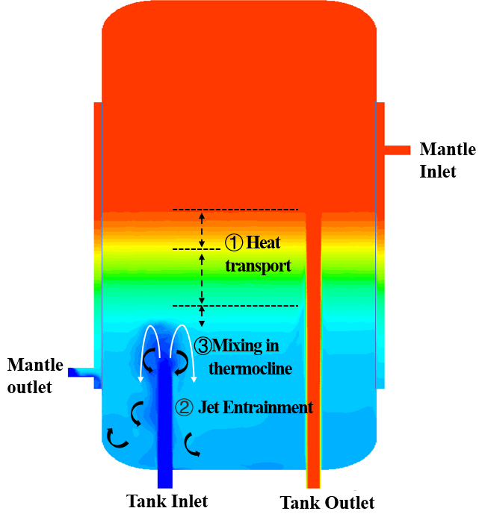
Effect of vertical buoyant jet in a thermally stratified solar water tank
Q. Li, X. Ding, Y. G. Zhang, T. Liu, W. F. Gao, W. X. Lin*
Solar Energy Research Institute, Yunnan Normal University, Kunming, Yunnan, China
Introduction
For energy considerations, the R_{i} number can be used to characterize the ratio between the potential energy required for vertical mixing and the turbulent kinetic energy available for the process. The definition of R_{i} number is:
The study of the flow parameters in the water tank shows that the mixing is mainly determined by the penetration depth of the jet, and the mixing occurs in the crown region of the negative buoyancy jet. The Ri number can be used to characterize the ratio between the potential energy required for vertical mixing and the turbulent kinetic energy that can be used for the process, so as to evaluate the stratification performance.
The thermal stratification of the solar hot water storage tank plays an important role in improving the thermal performance of the solar water heating device and increasing the solar thermal conversion efficiency. Energy-efficient storage can not only ensure a high actual heat output, but also maintain a usable temperature level to meet the needs of all operating cycles. Due to gravity and buoyancy, high-density fluid or cold water will be deposited in the lower part of the water tank, while low-density fluid or hot water will be deposited in the upper part of the water tank. A thermocline can be formed gradually between the hot zone and the cold zone inside the water storage tank, and a stable vertical temperature or density gradient can be maintained. Good sharp stratification can not only suppress the mixing and entropy generation in various operating cycles, but also reduce the ineffective volume or dead water area of the water storage tank that may account for 25% of the total volume [1].
During the water release stage of the solar water tank, when the incident cold water enters the bottom of the water tank, it starts to be entrained along the surrounding hot water layer. This entire process is called plume entrainment. In other words, plume entrainment is a process of heating the incident water. In the incident water, it rearranges its position in the water tank according to the matching available density of the surrounding fluid. This entrainment process increases the thickness of the thermocline through various mechanisms such as Kelvin–Helmholtz instability and Engulfment mechanism. Hess and Miller [2] used laser Doppler velocimeter (LDV) experiments to study the influence of the tank wall on the dynamics of the thermocline, and found that the formation of eddy currents was observed near the top of the tank wall. This is due to the buoyancy and pressure gradient caused by counter-acting convection.
Here g is the acceleration caused by gravity, β is the coefficient of thermal expansion, ΔT is the temperature difference between the water inlet and the temperature of the water tank and V is the characteristic inlet velocity. When the characteristic length L is the vertical height of the water tank, the global R_{ih} is obtained.
The variation of R_{ih} with dimensionless time under each working condition is shown in Fig.2. The results showed that the R_{ih} value decreases continuously with time, and the decreasing rate decreases with the increase of R_{ei} number. These results verified that the entrainment and mixing of negative buoyant jet in stratified water layer caused by cold water injection increase with the increase of R_{ei} number.
Results
The overall structure of the water tank is cylindrical, and the heat exchange surface between the inner tank and the mantle is cylindrical wall. When modelling the heat transfer of the mantle solar water tank, the heat transfer process is considered, including: convection heat transfer between the fluid and the inner surface of the heat exchanger, the convection heat transfer between the working fluid in the mantle and the outer wall of the mantle heat exchanger wall, and the heat transfer process in the inner and outer wall of the heat exchanger surface, etc. The heat transfer process is shown in Fig.1.
Fig.2. Time series of R_{ih} values in the discharging mode at different Re_{i} values.
Conclusions
The direct numerical simulation method is used to simulate the instantaneous flow characteristics in the solar hot water storage tank in the discharging mode. The results show that when the flow rate is low, the incident negatively buoyant jet is weaker, and the entrainment and mixing caused by it is not obvious; but with the increase of the initial Rei number, the negatively buoyant jet will increase, and the entrainment and blending will be more intense, and the mixed area also increase.
Methodology
Fig.1. Phenomenology of a stratified mantle solar water tank in discharging mode.
For a natural circulation indirect solar water heating system with a jacketed hot water exchange tank, the water tank structure is shown in Fig.1. The inner tank of the water tank is made of steel plate enamel. There is a mantle heat exchange device outside the inner water tank, and the interlayer is filled with circulating working fluid. The inlet and outlet of the used domestic water are located at the bottom of the water tank, and the hot water pipe goes deep into the top of the inner water tank through the draft tube. The inlet of the heat exchange working fluid is located at the upper part of the jacketed heat exchanger, and the outlet is located at the lower part.
An important mixing effect is produced when the cold fluid fed into the tank and mixing with the stored hot water in the form of buoyant jet. When passing through the storage hot water, the jet will entrain the surrounding fluid, so the volume flow will increase along the jet trajectory. This entrainment affects the transient temperature distribution in the water storage tank, because when the hot fluid is taken out of the water storage tank and supplemented with new cold fluid, convection occurs in the vertical direction. In addition, severe mixing will cause the change of average jet temperature. In turn, this will affect the size of buoyancy, trajectory and stratification height.
References
[1] Journals Bouhal T., Fertahi S., Agrouaz Y., et al. Numerical modeling and optimization of thermal stratification in solar hot water storage tanks for domestic applications: CFD study. Solar Energy, 157: 441-455 (2017).
[2] Journals C.F. Hess C. W. M. An experimental and numerical study on the effect of wall in a thermocline type cylinder enclosure – I Experiments. Solar Energy, 28: 145-152 (1982).

