Slide 1
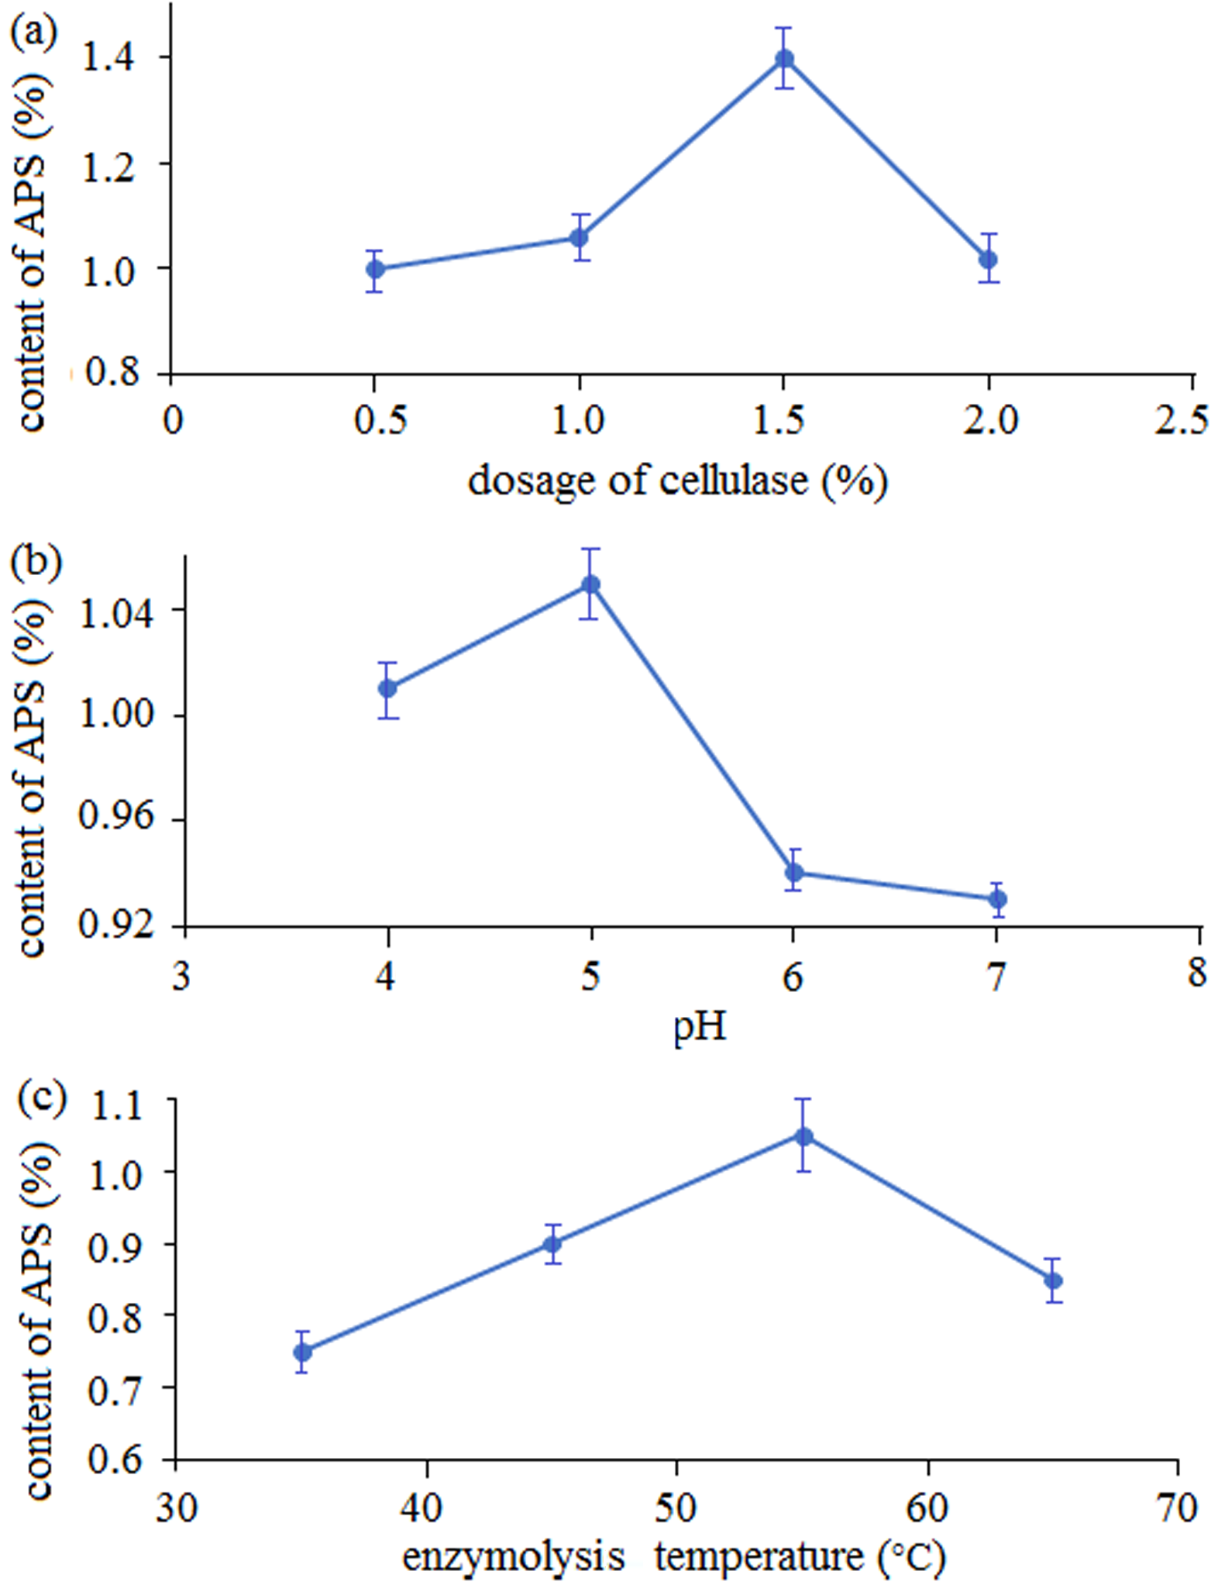
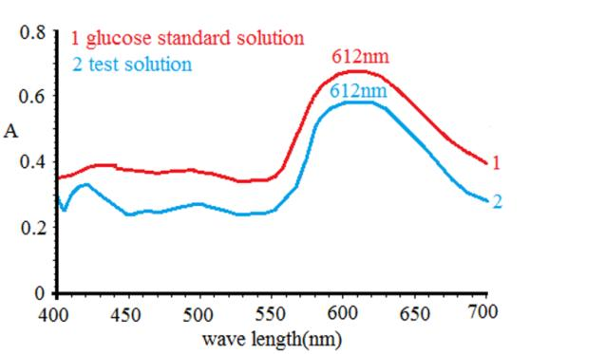
Comparative study of the extracting polysaccharides from Traditional Chinese Medicine Astragali Radix
in the field of new biological cellulase-assisted enzymes technology
Y. Sun, L.L Miao, Y.L Li*
Shanxi Medical University, School of Pharmacy, China
Introduction
standard monosaccharide.
6.1 Drawing of glucose standard curves
Glucose standard was weighed precisely to prepare the solutions with mass concentration of 12.5, 15,17.5, 20, 22.5, and 25 μg/mL glucose standard solution were prepared, and the mixed liquor was shaken well, then 5.0 mL of 0.2% anthrone-sulfuric acid solution was added, respectively. Heated for 5 min in a boiling water bath.The absorbance values (OD) of these solutions were measured for making standard curves.
6.2 Methodological verification of the precision
The OD values of the glucose standard solution (15 μg/mL) were measured six times under the maximum absorption wavelength, and the relative standard deviation (RSD) (%) value were calculated.
6.3 Methodological verification of the stability and the repeatability
The test sample solution (APS-E, 18 μg/mL) was determined every 10 min and lasted for 50 min under the maximum absorption wavelength, and calculate the RSD (%) as the stability. Furthermore, the RSD (%) of the other six portions same concentration solution were also tested for the repeatability of the method.
6.4 Methodological verification of the accuracy
The nine samples were divided into three groups, and then each group was added with different amounts of glucose standard. And measured the OD values, to calculate the recovery rate according to Eq. (1):
The recovery rate (%) = (the measured quantity after added standard substance – the known quantity of sample) × 100% / the mass of added standard substance (1)
6.5 Content determination for total polysaccharides from AR
Polysaccharides of APS-E and APS-W were formulated into a test solution of 18 μg/mL, respectively. The OD values of samples were determined to calculate total polysaccharides content (%) according to standard curve. The content was calculated as shown in the Eq. (2):
polysaccharide concent (%) = (C × D)/W ×100% (2)
where:
C - glucose concentration in the sample, μg/mL;
D - the dilution volume, mL;
W - mass of AR, μg.
2.1 Effect of dosage of cellulase on content of polysaccharides
As shown in the Fig.2 (a), with the increasing dosage of cellulase, the content of polysaccharides growed to top and decreased afterward. 1.5% was chosen as the optimum dosage of cellulase.
2.2 Effect of pH value on content of polysaccharides
As shown in Fig. 2 (b). The content increased with pH until it was up to 5.0 and then began to decrease. So, 5.0 was chosen as the optimum pH value.
2.3 Effect of temperature on content of polysaccharides
As shown in the Fig. 2 (c), at first the content increased, and when 55°C, it subsequently decreased with increasing temperature. Hence, 55°C was deemed as the optimal temperature.
Astragali Radix (AR), also well-known as Huangqi in China, it is derived from the dried root of perennial legume Astragalus membranaceus (Fisch.) [1-3]. Studies have shown that APS has significant immunomodulatory effects on antitumor and antiinfection [4]. APS-Ⅱ are the most immune active parts of Astragalus polysaccharides (APSs)[5]. The methods for herbal extraction, would bring different pharmacological effect. Currently, the most common polysaccharide extraction method is hot-water extraction and alcohol sedimentation. Enzyme assisted extraction technology offers many advantages, such as higher extraction yield, lower energy requirements and suitable for the organism to absorb owing to the imitative biological environment, compared to conventional extraction methods.
The conventional water reflux extraction was employed as the control group. Anthrone-sulfuric acid method was applied to determine the content of total polysaccharides (in terms of Glu) [11]. This research aims to describe a comparative study of the extracting polysaccharides from AR between the new biological cellulase-assisted enzymes technology and conventional extraction method. With total polysaccharides content as index, single factor experiments were employed to optimize parameters of the influencing factors such as the enzyme amount, enzyme treated temperature and the range of pH value.
Experimental
Fig.2. Results of single factors experiments (a) dosage of cellulase (b) pH value (c) enzymolysis temperature
1.Plant materials
AR slices were purchased from Datong of Shanxi. Cellulase was acquired from Zhejiang Yinuo Biotechnology Co., Ltd . D (+)-glucose was obtained from Shanghai Yuanye Biotechnology Co., Ltd .
2.Pre-treatment of AR slices
The slices were pulverized and passed through a 50-mesh sieve.Powder was ultrasoniced by 60~90% petroleum ether at normal temperature for 40 min and filtration. The solvent in the filter residue evaporates to obtain AR degreased powder.
3.Extraction of APS with cellulase
AR degreased powder was placed into a flask and added with distilled water. And heated in a water bath at designated dosage of enzyme, pH and temperature. After enzymolysis process, the extract was rapidly heated for 10 min in boiling water bath, cooled, filtered. The filtrate was concentrated and precipitated in the volumes of 95% ethanol, then stand for about 15 h. The polysaccharide precipitate was collected by centrifugation at 3000 r/min for 25 min, washed with anhydrous ethanol. The precipitate was dried in an oven at 60°C to get the crude enzymatic extraction polysaccharide (APS-E).
4.Optimization of cellulase-assisted enzymatic extraction conditions
A single factor experimental design was used,including dosage of cellulase (ranging from 0.5 to 2.0%), pH value (ranging from 4.0 to 7.0, pH was adjusted to the desired value with 1 mol/L HCl and 1 mol/L NaOH), and temperature (ranging from 35 to 65°C) [12-14].
5.Extraction of APS with water reflux as the control group
The water reflux extraction was carried out using the same material-to-water ratio 1:30 (g/mL) and the same time of extraction (120 min). The filtrate was concentrated and then submitted to the same steps that were taken in the cellulase extraction to get the crude water extraction polysaccharide (APS-W) .
.6.Content determination for total polysaccharides with UV-vis spectrophotometry
Total polysaccharides were quantitatively analyzed by anthrone-sulfuric acid method using glucose as the
3. The content determination for total polysaccharides of AR
The content of AR samples obtained with cellulase-assisted treatment under the optimized extraction conditions and in control group were 4.82% and 1.56% , respectively. It suggests that although, the content of cellulase-assisted method used to extract polysaccharide was a litter lower by far，but the macromolecules in AR were extracted quickly and transformed into small molecules with molecular weight less than 10 kDa on the basis of simulating the temperature and enzyme-like environment. Therefor it provides theoretical reference for further development APSs.
Results
Conclusions
1.1 Drawing of glucose standard curves
UV wavelength scanning for standard solution and test solution were showed in Fig.1. The maximum absorption of standard sample and test sample at 612 nm. The linear regression equation of glucose was equal to Y = 0.0289 X - 0.0068 (Y was OD value, X was glucose concentration), of which r= 0.9995, range of linearity was 12.5~25 μg/mL.
The main conclusions drawn from all work are:
- the extraction conditions were optimized as follows: dosage of cellulase, 1.5%; temperature, 55°C and pH value, 5.0.
- The content of AR samples obtained with cellulase-assisted treatment under the optimized extraction conditions and in control group were 4.82% and 1.56% ;
- The macromolecules in AR were extracted quickly and transformed into small molecules with molecular weight less than 10 kDa, which could be absorbed effectively by the digestive tract in the human body.
References
Fig. 1. Results of wavelength scanning for glucose
standard solution and test solution
[1] Books China Pharmacopoeia Committee. Pharmacopoeia of the People’s Republic of China. China Chemical Industry Press, Beijing, 2020.
[2] Journals Z. Chen, L. Liu, C. Gao, W. Chen, C. Wong, P. Yao, Y. Yang, X. Li, X. Tang, S. Wang, Y. Wang. Astragali Radix (Huangqi): A promising edible immunomodulatory herbal medicine. Journal of Ethnopharmacology 258, 112895-112912 (2020).
[3] Journals Z. Guo, Y. Lou, M. Kong, Q. Luo, Z. Liu, J. Wu. A Systematic Review of phytochemistry, pharmacology and pharmacokinetics on Astragali Radix: implications for Astragali Radix as a personalized medicine. International Journal of Molecular Sciences 20, 1463-1506 (2019).
[4] Journals K. Li, Y. Cao, S. Jiao , G. Du, Y. Du, X. Qin. Structural characterization and immune activity screening of polysaccharides with different molecular weights from Astragali Radix. Frontiers in Pharmacology 11, 582091-582108 (2020).
[5] Journals Y. Cao, K. Li, X. Qin, S. Jiao, Y. Du, S. Li, X. Li. Quality evaluation of different areas of Astragali Radix based on carbohydrate specificchromatograms and immune cell activities. Acta Pharmaceutic Sinica 54, 1277-1287 (2019).
1.2 Results of methodological verification
The RSD (%) of the precision, stability and repeatability of the experiments is 0.2%, 1.9% and 1.0%, respectively. They were all with in 2%.
2. Single factor experiments analysis
The optimal conditions for enzymatic hydrolysis of factors were obtained by single factor test in the preliminary experiments.

