Slide 1


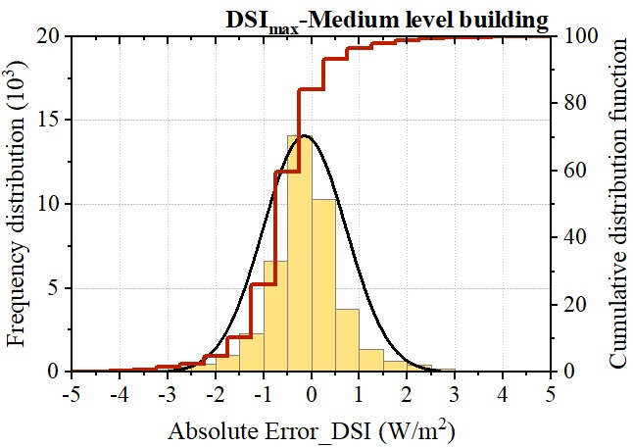
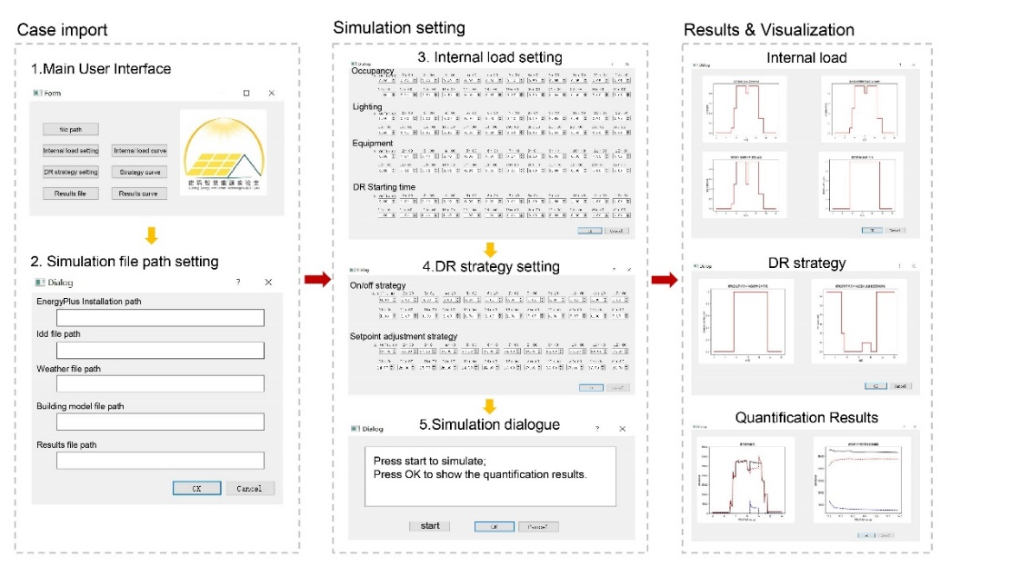
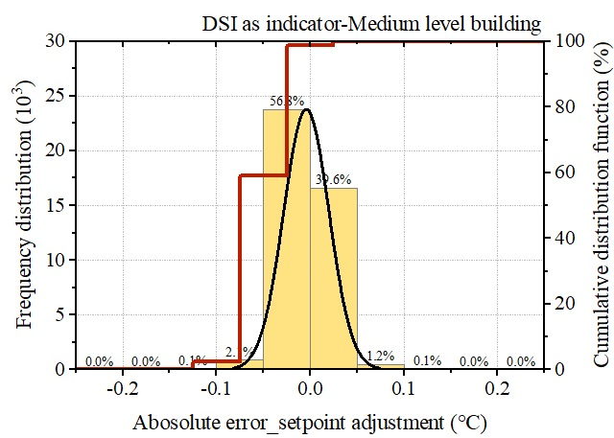
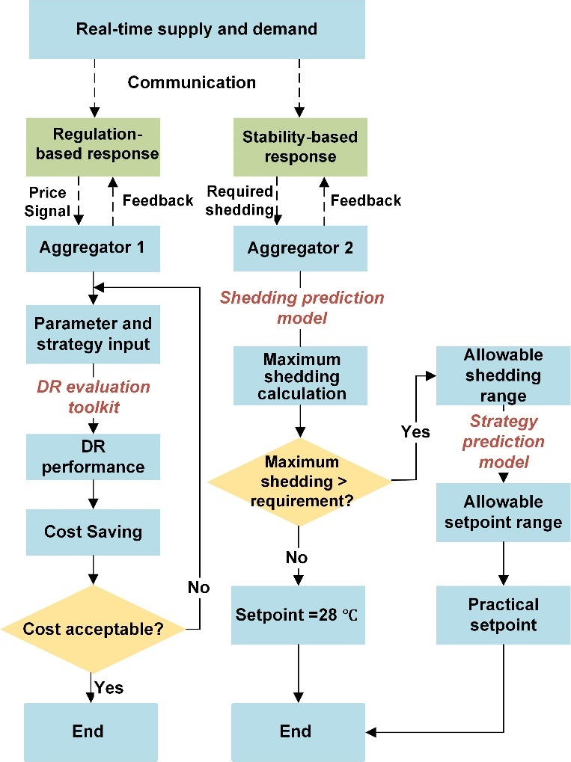
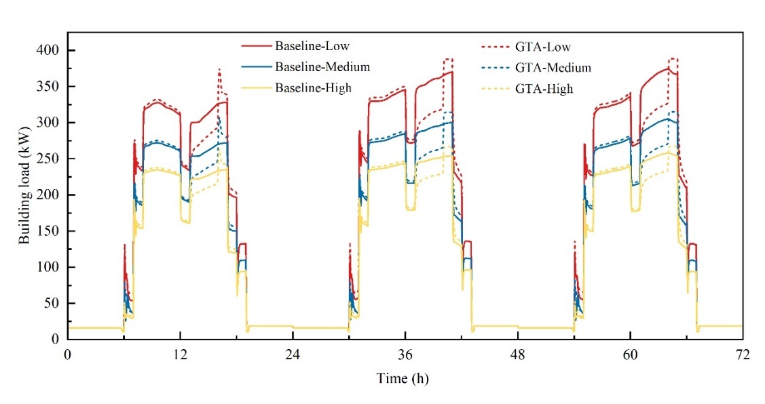
Evaluation and Control of Global Temperature Adjustment Strategy for Fan-coil Air Conditioning System
Based on Model Prediction
W. Zhao¹, J. Song¹, J. Peng^{1,2 *}, J. Cao^{1,2 **}, R. Yin¹, Z. Luo¹, B. Zou¹, J. Guo¹
¹College of Civil Engineering, Hunan University, Changsha 410082, China
²Key Laboratory of Building Safety and Energy Efficiency of Ministry of Education, Hunan University, Changsha, Hunan, China
Introduction
    advance for response strategies adjustment. On stability-based mode, consumers are informed of expected load shedding or shifting and the responding incentive payment before demand response event. demand response shedding and strategy prediction models was developed by using artificial neural network. Shedding prediction models determine the allowable shedding range. The strategy prediction model is used to predict the appropriate setpoint adjustment according to allowable range.
Load shedding prediction model
The shedding prediction model shows satisfactory fit between actual and predicted values ,as indicated by MAPE values below 15%. Fig. 4 shows absolute errors between actual and predicted values for medium-level building as an example, over 80% of data has a prediction error below ±1 W/m² in demand shedding intensity.
setpoint adjustment prediction model
For buildings with all energy levels, desirable adjustment predictions can be observed through the model with R²>0.99 and MAPE<3%. Almost all of the data in Fig. 5 are within the acceptable error range of ± 0.25 ℃ , exceeding 99%. This suggests that the prediction model can achieve dynamic and precise control in demand response programs.
Traditional demand response performance evaluation is based on detailed energy simulation [1,2] , while quick assessment and dynamic performance assessment which varies under different conditions cannot be achieved.
Demand response quantification using simplified models, such as linear regression model [3] , show clear empirical formulas between performance and strategies, however, it is of high cost for large database establishment as the foundation of model fitting.
The secondary development of building energy software achieves convenient and fast demand response quantification [4], while optimal strategy cannot be recommended for more stable demand response performance.
To solve the above issues, a dynamic demand response performance quantification and control framework were proposed. Specifically, a novel dynamic demand response performance evaluation toolkit was first developed with EnergyPlus, a building energy simulation software, as the calculation foundation. The toolkit is used for quick demand response evaluation and regulation. Prediction models for demand response performance evaluation and control were established by using artificial neural network, based on database of quantification results. Multiple indicators and medium-sized office with different energy levels were adopted to verify the accuracy and robustness of the prediction models.
Model establishment
Demand Response performance evaluation toolkit
The demand response dynamic evaluation toolkit utilizes EnergyPlus as its calculation kernel. Fig. 2 shows the user interface and operation process of the toolkit. Load shedding intensity (DSI) and demand response potential (DR_{flex}) are demand response performance indicators.
Fig. 4. Accuracy of load shedding prediction for medium-level building.
Proposed framework
Fig. 2. User interface and operation process of the dynamic DR evaluation toolkit.
    The demand response performance quantification and control framework was proposed considering two smart grid modes to balance supply and demand: regulation-based mode and stability-base mode, as shown in Fig. 1.
PREDICTION MODEL ESTABLISHMENT
Dynamic prediction models were established for load shedding and setpoint adjustments. Artificial neural network was adopted for the prediction.
Dry bulb temperature and relative humidity, parameters regarding internal loads, and demand response strategy and performance indicators were adopted for input parameters [5]. A total of 5000 combinations of parameters were obtained through the Latin hypercube sampling method and then used to generate totally 140,000 samples throughout the whole cooling season. The training dataset consisted of 70% of the samples while the remaining 30% was used as the test dataset.
    Fig. 5. Time evolution of energy exchanged rates in the BHE and in the water-water heat exchanger.
Conclusions
Results
  The main conclusions are as follows:
  - The demand response performance evaluation toolkit achieves quick and dynamic performance assessment;
  - The performance prediction model was able to predict the maximum load with an average absolute percentage error of 15%.;
  - The setpoint adjustment prediction model achieved an average absolute percentage error of 3% and ensures accurate response in the setpoint adjustment event.
Demand Response performance evaluation toolkit
2 ℃ global temperature adjustment during 13:00-16:00 for different building energy levels were analyzed. Fig. 3 obvious load shedding during demand response period in each case indicates effective demand response simulation in the toolkit. Moreover, buildings with lower energy saving performance shows better response performance. Multiple strategies were further evaluated by using the toolkit and strategies integrating global temperature adjustment outperformed other strategies.
References
    Fig. 1. quantification and control framework
[1] W. Li, Y. Chu, P. Xu, Z. Yang, Y. Ji, L. Ni, Y. Bao, K. Wang, A transient model for the thermal inertia of chilled-water systems during demand response. "Energy and Buildings", 2017, V. 150 p. 383–395 .
[2] W. Li, L. Yang, Y. Ji, P. Xu, Estimating demand response potential under coupled thermal inertia of building and air-conditioning system. "Energy and Buildings", 2019, V. 182 p. 19–29.
[3] R. Yin, E. C. Kara, Y. Li, N. DeForest, K. Wang, T. Yong, M. Stadler, Quantifying flexibility of commercial and residential loads for demand response using setpoint changes. “Applied Energy", 2016, V. 177 p. 149–164
[4] R. Yin, P. Xu, M. A. Piette, S. Kiliccote, Study on Auto-DR and pre-cooling of commercial buildings with thermal mass in California. "Energy and Buildings", 2010, V. 42 p. 967–975 .
[5] J. Wang: Influence of different factors on meteorological data of HVAC. Master's Thesis. Xi’an University of Architecture and Technology, Xi,an, China, 2020.
    The demand response performance quantification and control framework was proposed considering two smart grid modes to balance supply and demand: regulation-based mode and stability-base mode, as shown in Fig. 1. The regulation-based mode sends dynamic electricity pricing to consumers based on real-time supply and demand conditions. A new dynamic demand response performance evaluation toolkit has been developed to calculate cost savings in
    Fig. 3 Demand response performance for buildings with different energy levels.

