Slide 1
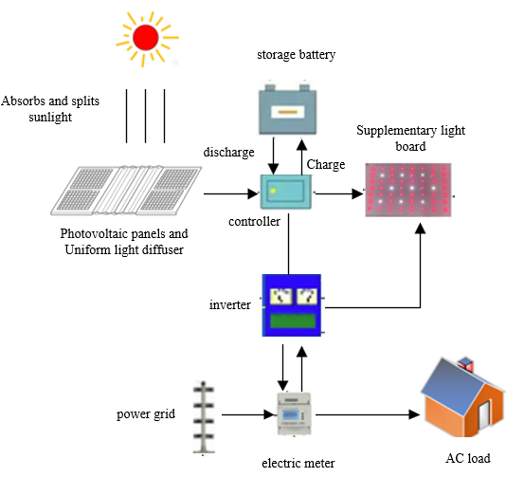
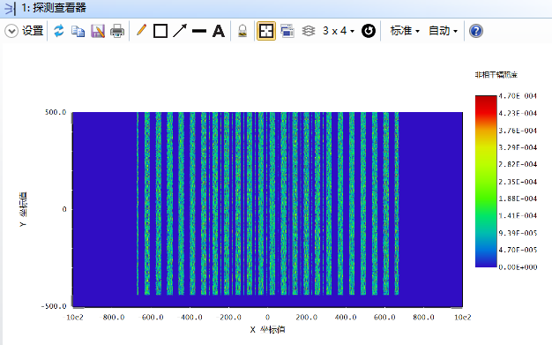
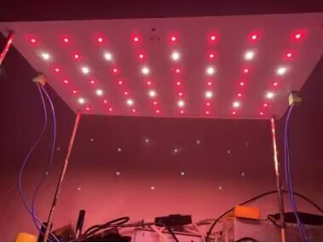
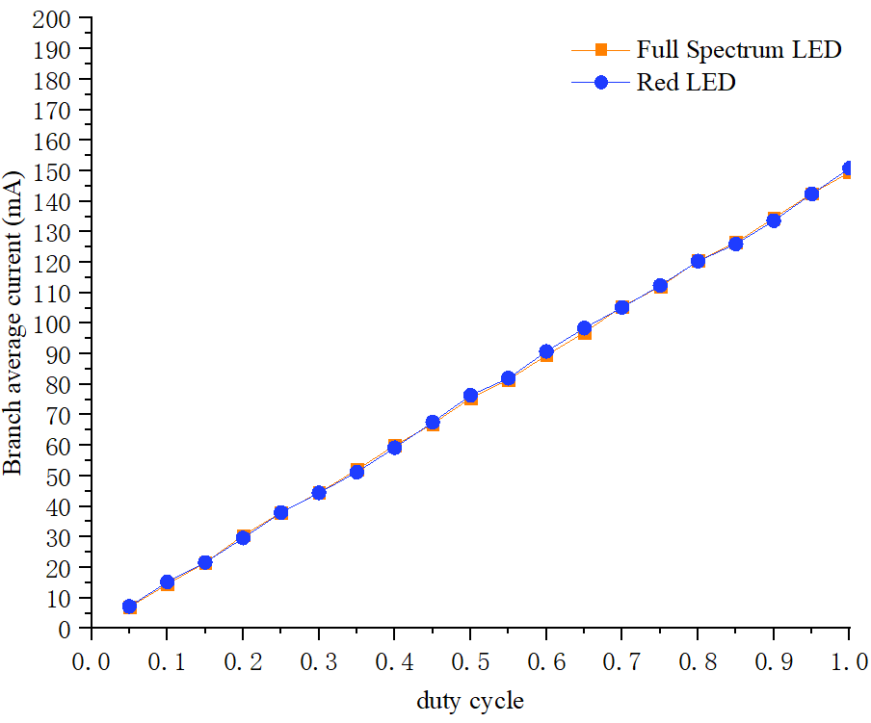
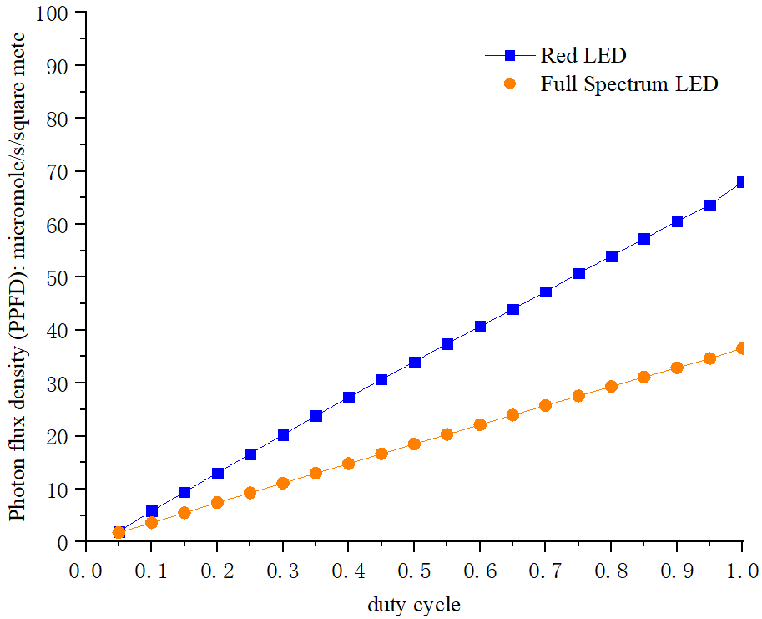
A control method for multiple light sources in photovoltaic agriculture
Wanjiang Bai ¹, Qinghua Lyu ^{1*}, Zhuoyi Ling ¹, Xinfang Zhao ¹,Hui Lyu ¹, Zhongsheng Zhai², Saffa Riffat³
¹National “111 Research Center” Microelectronics and Integrated Circuits，School of Science， Hubei University of Technology
²School of mechanical engineering, Hubei University of Technology, Wuhan 430068, China
³Department of Architecture & Built Environment,The University of Nottingham, Nottingham,NG7 2RD,UK
Introduction
We can control Optical quantum flux density by controlling the duty cycle, and then realize the precise control of supplementary light, Provide a suitable light environment for the crops below
The combination of photovoltaic and agriculture has become a development trend, but there are problems such as uneven light and insufficient light for plants in photovoltaic environment, which makes it difficult to achieve the most suitable light environment for plant growth Multi-light source control is a good light control scheme for photovoltaic agriculture, experimental method have been used to study its feasibility.
Uniform Light diffuser design and
simulation
where:
PPFD- the number of moles of the photosynthetic photons passing through a unit area per unit time;
$n_{A}$- the Avogadro constant,;
$h$- the Planck constant;
c- speed of light, $c=2.979×10^{8}m⋅s^{−1}$;
$E_{e}\left(λ\right)$- the spectral irradiance;
λ- wavelength of light, nm;
$E_{v}$- The amount of luminous flux received by an object per unit area is called luminosity;
$v\left(λ\right)$- the number of moles of photons per unit time per wavelength interval through the surface of the object;
${ K}_{m}$- the maximum value of the human eye visual function, and the subscript v indicates the human eye visual metric, ${ K}_{m}=683lm∙W^{−1}$;
$K_{0}$- the conversion coefficient of Photosynthetic Photon Flux Density of plants to illuminance.
Separating sunlight through a glass with a suitable refractive index and structure, so that there is uniform illumination under it and photovoltaic panel.The structure of uniform light diffuser can be Optimised design according to size and height requirements. Designing structural parameters and simulate with software Solidwords and ZEMAX.The structure is shown in the Fig.5 and simulation is shown in the Fig.6.
Intelligent lighting control
system for plants
The purpose of this paper is to design a system with multiple light sources to achieve high uniformity of daily accumulated light in photovoltaic agriculture. The photovoltaic panel can generate power in the daylight, and use the power to continue lighting the plants in the night. It can efficiently use solar energy, and can make the plants be better growth, yield and quality of plants under photovoltaic devices through supplemental light. The overall structure of the system is shown in Fig.1.
LIGHT ENVIRONMENT CONTROL
DLI is a more important parameter for plants than the photoperiod and light intensity [2]. Daylight integral (DLI) is the total amount of photosynthesis delivered to the plant per day [3-4]. The product of photosynthetic photon flux density (PPFD) and photoperiod is the daylight integral (DLI).We can Complementary suitable PPFD and photoperiod.
Supplementary light board design
and testing
Fig. 5 The structure of the uniform light diffuser.
The array of lamp beads for the supplemental light board was performed by using an improved particle swarm algorithm and a new equal-difference LED array [5].The control of the light environment was verified in the experiment. Test results are given in Fig.3 and Fig.4,Linear relationship between average current and light quantum flux density and duty cycle.
Fig 1. Schematic diagram of the overall structure
Fig. 6 The result of simulation.
COMPLEMENTARY LIGHT SYSTEM
When the day light begins, the sunlight efficiently shines on the solar cells for power generation, which is delivered to the battery storage for charging and discharging. At the same time part of the sunlight through the levelling glass plate to the plants below. When the day's sunshine is over, judge whether the plant's lighting requirements are met, fill in the light if it is insufficient, and connect to the grid for electricity if it is satisfied.
Conclusions
Fig. 2. Schematic diagram of supplementary light board
It can realize photovoltaic power generation and solves the problems of insufficient light and uneven light reception of plants under photovoltaic panels. and accurately control the supplementary light by regulating the PWM signal, so as to achieve accurate light supplementation on the needs of plants, and the excess electricity can be sent to the power network, which truly realizes agricultural light complementarity and efficient utilization of solar.
LIGHTING DEVICE DESIGN REQUIREMENTS
the photometric system of the human eye cannot be used in the field of plant lighting [1]. But the photometric parameters for human eye can be used to guide the design of plant LED light sources. The conversion coefficients between plant photometry and photometrics need to be studied to design the photometric parameters of plant light sources according to the photometric parameters required for plant growth.
$PPFD=\int_{400}^{700}{\frac{E_{e}\left(λ\right)λdλ}{n_{A}hc}}$ (1)
$E_{v}=K_{m}\int_{380}^{780}{E_{e}}\left(λ\right)V\left(λ\right)dλ$ (2)
From equations (1) and (2), we can obtain $K_{0}$ ,and the expression is
$$K_{0}=\frac{PPFD}{E_{v}}=\frac{\int_{400}^{700}{\frac{E_{e}\left(λ\right)λdλ}{n_{A}hc}}}{K_{m}\int_{380}^{780}{E_{e}}\left(λ\right)V\left(λ\right)dλ}$$
References
Fig. 3. Average branch current for different duty cycles.
[1]Olvera-Gonzalez E, Alaniz-Lumbreras D, Torres-Argüelles V, et al. A LED-based smart illumination system for studying plant growth. Lighting Research & Technology 46(2), 128-139 (2014).
[2] Lee, H . B, Lee , J . H, An, S . K, Park, J . H, Kim, K . S. Growth characteristics and flowering initiation of Phalaenopsis Queen Beer ‘Mantefon’ as affected by the daily light integral. Hortic. Environ. Biote 60, 637–645 (2019)
[3]Faust, J . E, Logan, J. Daily Light Integral: A research review and high-resolution maps of the United States. HortScience 53, 1250–1257 (2018).
[4] A. Christiaens, P. Lootens, I. Roldán-Ruiz, E. Pauwels, B. Gobin, Van Labeke, M . C. Determining the minimum daily light integral for forcing of azalea (Rhododendron simsii). Scientia Horticulturae 177, 1–9 (2014).
[5]Zhenxing MING, Qinghua LV, Yue MING, Wei ZENG, Hui LV, Jie ZHANG. Optimization of LED light source array based on improved particle swarm algorithm. Applied Optics 43(03), 524-531+543 (2022).
Fig. 4. PPFD diagram for different duty cycles.

