Slide 1
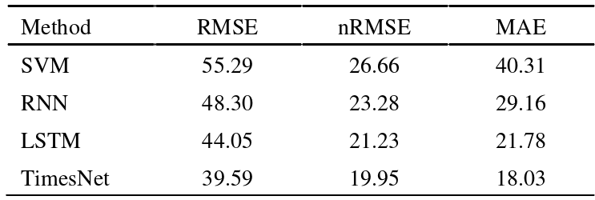
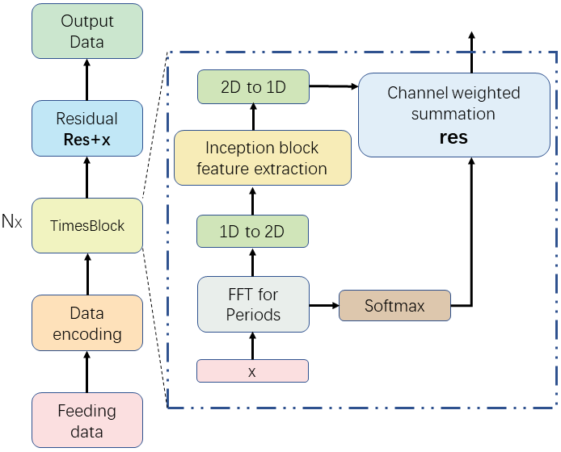
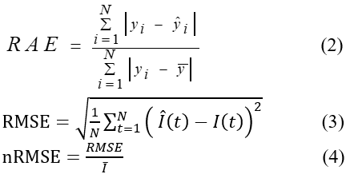
A solar irradiance prediction method based on TimesNet model
He Zhao¹, Xiaoqiao Huang^{1,2,*}
1 School of Physics and Electronic Information, Yunnan Normal University, Kunming, Yunnan, China
2Yunnan key lab of optic-electronic information technology, Kunming, Yunnan, China,
Introduction
proposed to process the extracted k 2D- variations. The specific framework is shown in Figure 1. The InceptionBlock with shared.
parameters is selected for feature capture, that is, inception(·), making the model size invariant to the choice of hyperparameter k. For the extracted temporal features, we transform them back into a one-dimensional space in order to perform adaptive aggregation, and the resulting one-dimensional(1D) representations are weighted and summed with their corresponding frequency intensities to obtain the overall features, where we use Trunc(·) to truncate the fill level of length pi × fi to the original length N.
Results
With the continuous consumption of traditional fossil energy and the consequent environmental pollution, people gradually turn their attention to clean and resource-rich solar energy. However, solar power generation is intermittent and unstable due to various meteorological factors, which will greatly endanger the safe operation of power grids. Solar irradiance is the main factor causing instability in solar power generation, so accurate prediction of solar irradiance is a key requirement to ensure normal scheduling and operation of solar systems.
The original 1D structure of time series can only represent the changes between adjacent time points. In fact, real-world time series are usually multi-periodic, such as day-period and month-period; moreover, the time points within each period are dependent (e.g., 1:00 and 2:00 today), and the time points within different adjacent periods are also dependent (e.g., 1:00 today and 1:00 tomorrow). So, in order to extract these periodic connections and improve the prediction accuracy. In this paper, a solar irradiance prediction method based on TimesNet model is proposed.
Compared with the traditional convolution-based and Transformer series models, the experimental results show that the TimesNet model is able to capture the periodic features more accurately than the traditional convolution-based and Transform series models. The proposed method in this paper with good performance in short-term irradiance prediction.
Table 1. Evaluation metrics compared proposed models with other models for one-hour ahead prediction.
Conclusions
Achieving accurate forecasting for PV power generation is important for providing high-quality electric energy for end-consumers and for enhancing the reliability of power system operation. Currently advanced timing methods, convolution-based methods are insufficient in modeling long-term dependencies, while transformer-based methods rely on attention between discrete time points, making it difficult to mine timing dependencies to adapt to complex real-world Variety.In this study, TimesNet converts 1D to 2D, capturing both intra-time-period dependencies and adjacent time-period dependencies. It can effectively improve solar irradiance prediction accurately. The results provide a new and effective feature extraction method for study of solar irradiance prediction based on TimesNet model. The performance of the proposed method is demonstrated with a real-world dataset. Comparisons with LSTM, recurrent neural network (RNN), Convolutional Neural Networks(CNN),and multi-layer perceptron (MLP) models are also presented. The values of three performance evaluation indicators, MBE, MAPE, and RMSE, show that the proposed model exhibits superior performance in both forecasting accuracy and stability.
Fig.1. The solar irradiance prediction framework $based$ on TimesNet.
Methodology
The above steps are superimposed several times in the form of residuals to obtain the final output. As for layer 1, the original data is projected into a one-dimensional(1D) depth feature space using the embedding layer. During the calculation process of the whole model, the input sequence changes from 1D to 2D, and then from 2D to 1D again, besides, the features within and between periods are always preserved.
Suppose there are N time series of length T and the original 1D data is X_{1D}. Firstly, in order to represent the inter-periodic variation, the time series is analyzed in the frequency domain by Fast Fourier Transform (FFT) as follows, where the major periods will present the frequency components with corresponding high amplitudes. The hyperparameter k is set and only the frequency components corresponding to the top k largest amplitudes are taken[1].
Experiment
DATASET
The data set used in this paper is located in Folsom, USA. The data set mainly includes air temperature, humidity, historical irradiance, wind speed and other related weather parameters. They are from the National Solar Radiation Database and Instrumentation Data Center (MIDC), provided by the National Renewable Energy Laboratory at https://midcdmz.nrel.gov.
EVALUATION METRICS
FFT(·) and Amp(·) denote the computation of FFT and amplitude values. a ∈ R^{T × C} denotes the computed amplitude at each frequency, Avg(·) denotes averaging from N dimensions with the most significant frequency {f₁, · · ·, f_{k}} corresponding to k period lengths {p₁, · · ·, p_{k}}. If the sampling cannot be completed exactly according to the frequencies, the time series is filled with 0 to f_{i}*p_{i} lengths. Then, we can easily handle the temporal 2D variation using 2D convolution.
A single 2D data is converted into multiple by FFT, and the TimesBlock module is
References
[1] Wu H, Hu T, Liu Y, et al. TimesNet: Temporal 2D-Variation Modeling for General Time Series Analysis[J]. arXiv preprint arXiv:2210.02186, 2022.
[2]Dazhi Yang,Jan Kleissl,Christian A. Gueymard,Hugo T.C. Pedro,Carlos F.M. Coimbra. History and trends in solar irradiance and PV power forecasting: A preliminary assessment and review using text mining[J]. Solar Energy,2018,168.
[3]HaixuWu, Jiehui Xu, JianminWang, and Mingsheng Long. Autoformer: Decomposition transformers with Auto-Correlation for long-term series forecasting. In NeurIPS, 2021.

