Slide 1
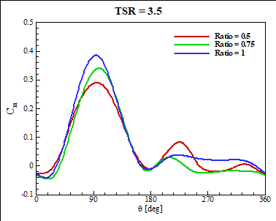
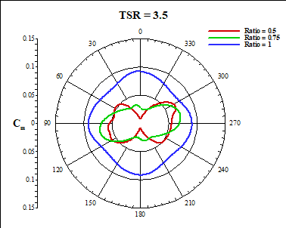
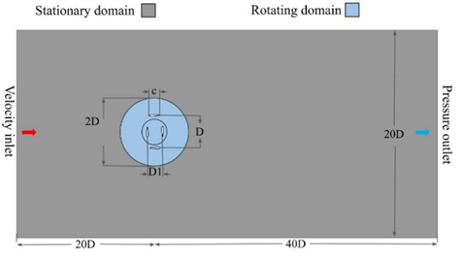
INVESTIGATION OF THE AERODYNAMIC CHARACTERISTICS IN
TWIN-ROTOR CAROUSEL WIND TURBINES.
Zh. Baizhuma¹, R. Manatbayev¹, M. Isatayev¹, N. Kalasov¹, A. Kelimkhanov^{1*}
¹Al-Farabi Kazakh National University, Faculty of Physics and Technology, 71 Al-Farabi Avenue, 050040 Almaty, Kazakhstan.
Introduction
The growing demand for renewable energy sources has stimulated the development of new wind turbine designs. One such innovative area is the development of vertical-axis wind turbines (VAWT) [1]. Unlike traditional horizontal-axis wind turbines, vertical-axis wind turbines have several significant advantages such as independence from wind direction, simpler design and efficient operation even in turbulent wind flow conditions. [2].
The use of double rotor designs, where two rotors rotate in the same direction, is considered to be a promising direction, which allows increasing the power factor [3].
In this paper, the aerodynamic performance of a double rotor carousel wind turbine is investigated based on numerical simulation. The main objective is to determine the dependence of chord length, rotor diameter and rotor spacing on the power factor and overall plant efficiency.
numerical simulation using Ansys Fluent software. The modelling was performed in a two-dimensional configuration, which allowed for a reduction in computational load while ensuring result accuracy.
The turbine geometry was created according to the following parameters as listed in Table 1.
Table 1. Main parameters of the numerical experiment:
---------------------------------------------------------------
Wind speed Value
----------------------------------------------------------------
Wind speed 10 m/s
Chord length (с) 0.25 m
Diameter 2.0 m
Blade profile NACA 0021
Number of blades 4
Rotor diameter (D) 1.0 m
Ratio of two diameters (D/D1) 0.5, 0.75, 1.00
Tip speed ratio 2.5, 3, 3.5, 4, 4.5
After the turbine geometry is determined, the next task is to design the ratio of diameters, or finalize the combination of rotor diameters, as listed in Table 2.
Table 2. Parameter combinations of the D/D1:
----------------------------------------------------------------
Rotor diameter Rotor diameter Value
----------------------------------------------------------------
1.00 0.50 0.5
1.00 0.75 0.75
1.00 1.00 1
Three different diameter ratios are selected, ranging from 0.5 to 1.0. All these values are considered practically applicable for twin rotor wind turbines. Once the diameter of the outer rotor (e.g. 1 m) is fixed, the diameter of the inner rotor is determined according to the selected ratio (e.g. 0.5 × 1 m, 0.75 × 1 m, 1.0 × 1 m). This approach ensures that the design is compatible with a variety of real-world use cases.
    Fig. 2. Torque coefficient at different diameter ratios
  Figure 3 shows the curves of torque coefficient Cm as a function of rotational speed (TSR) as well as the azimuthal angle of the blade. The analysis confirms the following:
  • At smaller diameter ratios, the inner turbine suffers greatly from wake by the flow of the outer turbine, an extensive low-pressure zone is visible.
  • As the ratio increases (closer to 1.0), the wake of both rotors begins to seriously overlap, which gives an increase in turbulence and torque fluctuations, but can produce higher peak Cm values at optimum conditions.
  These results are in agreement with wind tunnel experiments demonstrating the impact of rotor spacing and turbulence on performance optimization [6].
Design methodology
    In a twin-rotor carousel wind turbine, two vertical rotors are arranged around a common axis of rotation. The rotation is carried out in the same direction. The outer rotor is blown by a relatively undisturbed flow, while the inner rotor is affected by a turbulent wake caused by the rotation of the outer rotor.
    The need to determine the optimal ratio of diameters, chord length and interval between the rotors is due to the desire to effectively utilize the positive effects of mutual streamline and avoid excessive turbulence amplification during the operation of the plant [4].
    The main design factors include:
    • Profile of blades
    • Number of blades
    • Blade chord (c) and rotor diameter (D)
    • Tip speed ratio (TSR)
    • Ratio of diameters (D/D1)
    In a twin rotor carousel wind turbine design, both rotors are located on the same axis of rotation but have different distances from it (Fig. 1).
Results
    The conducted study shows that the twin-rotor carousel wind turbine has high aerodynamic efficiency with proper selection of geometrical parameters. Optimization the rotor spacing allows to significantly increase the power factor compared to conventional designs.
    Fig. 3. Variation of torque at different values of diameter ratio
Conclusions
Figure 2 shows the curves of torque coefficient Cm as a function of tip speed ratio (TSR) as well as the azimuthal angle of the blade. The analysis confirms the following:
1. Small diameter ratios (e.g., 0.5) result in relatively low values over a large TSR interval because the inner rotor operates in the turbulent flow of the outer rotor.
2. Intermediate ratios (around 0.75) give a more balanced result: the inner rotor is large enough to generate a noticeable torque, while not being overpowered too much by the influence from the outer rotor.
Identical diameters (1.0) provide the highest peak of
Cm, especially at TSRs in the range of 3.0-3.5. However, at higher TSRs, significant torque pulsation can occur due to the strong mutual influence of the flows around both rotors.
In Figure 2, it can be traced how Cm varies from 0° to 360° azimuthal angle. The following features can be noted:
The maximum positive values usually occur in the 90°-150° sector, where the blade is optimally oriented towards the flow.
As the TSR increases, the peak torque increases, but the azimuth spread of Cm oscillation also increases.
    Fig. 1. Rotor placement
References
[1] Shchur et al., Energies, 2023
[2] Sheldahl & Klimas, Sandia Labs
[3] Tong et al., Energy, 2023
[4] Hezaveh et al., Wind Energy, 2017
[5] Rezaeiha et al., Renewable Energy, 2017
[6] Peng et al., Energy, 2017
Method
The study is based on the investigation of the aerodynamic behavior of a twin-rotor carousel wind turbine with different rotor diameter ratios. The analysis of aerodynamic characteristics was carried out through

