Slide 1



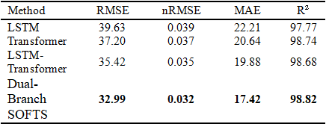
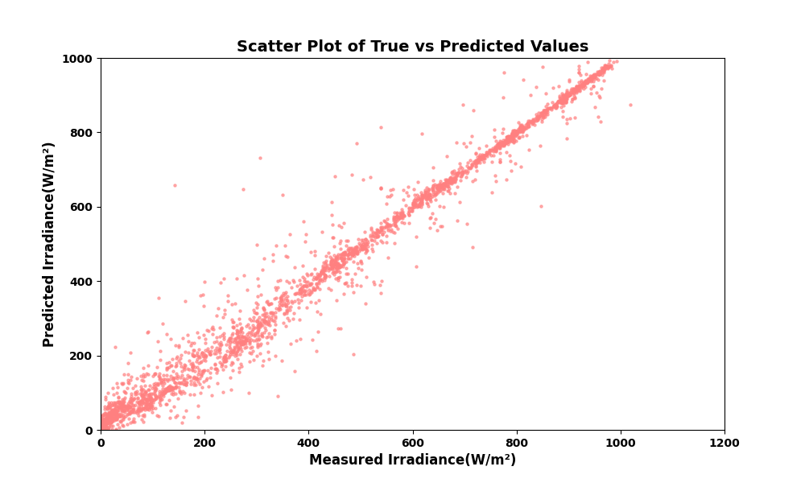
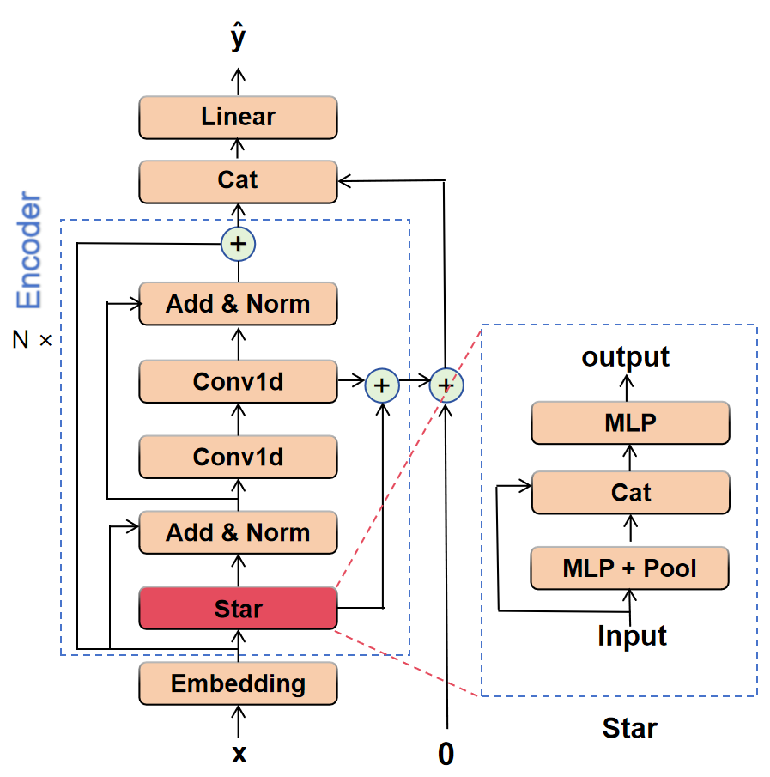
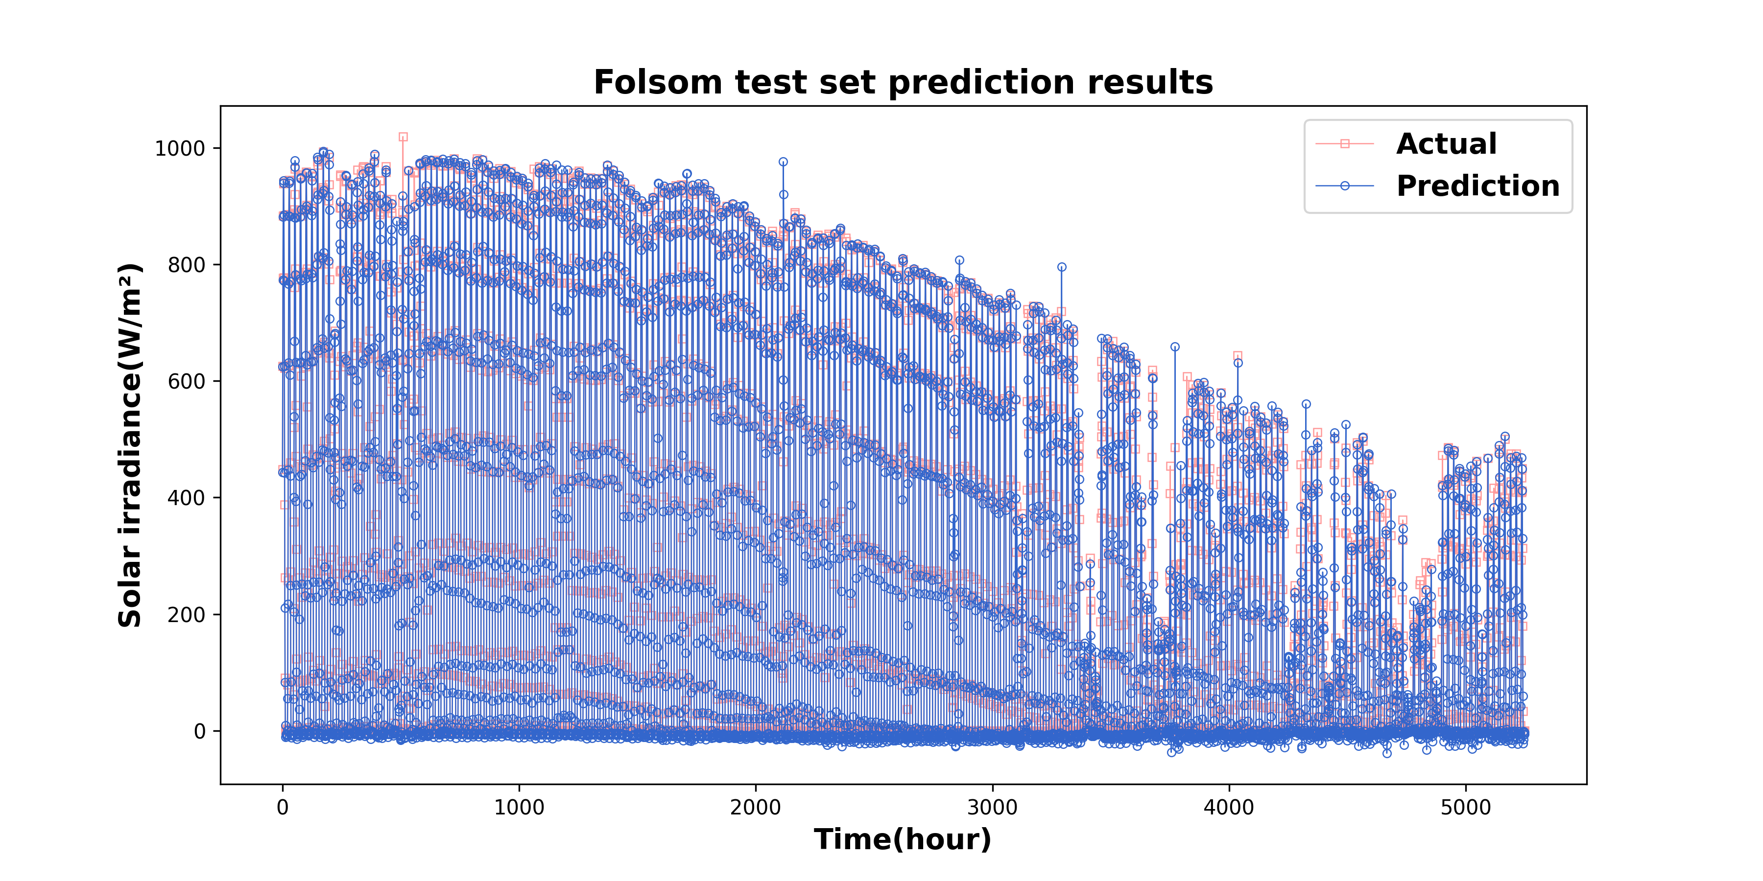
Dual-Branch SOFTS for Hourly Solar Irradiance Prediction
Liuyangrui Hui¹, Xiaoqiao Huang^{1,2,*} , Yonghang Tai^{1, 2}
1 School of Physics and Electronic Information, Yunnan Normal University, Kunming, Yunnan 650500, China
2Yunnan Key Lab of optic-electronic Information Technology, Kunming, Yunnan 650500, China
Introduction
As a key renewable energy source, solar energy has driven the rapid development of photovoltaic (PV) power generation. However, the intermittency and non-stationarity of solar irradiance pose challenges to grid integration and dispatch management. Hourly irradiance prediction requires models to simultaneously capture long-term periodic trends (such as seasonal variations) and short-term dynamic fluctuations (such as cloud movements). Traditional models suffer from such problems as the inability to capture both global and local features simultaneously and neglect correlations between features. To address this, this paper proposes a dual-branch SOFTS-based model for hourly irradiance prediction. The model first uses a Star module to interact information between different features, then decomposes the process into two parallel pathways: a global branch to capture long-range correlations and a local branch to model short-term temporal details. The two branches operate in parallel and are fused via temporal concatenation, enabling the model to leverage complementary information across different scales.
    forecast data can be incorporated to further improve the model's performance. Overall, the Dual-Branch SOFTS model performs well in solar irradiance prediction but requires continuous improvement to adapt to practical applications.
During the training process, iteratively adjust the model's parameters. This iterative adjustment helps the model gradually learn the inherent patterns and relationships in the training data, reducing the value of the loss function and improving the model's prediction accuracy.
4. Model Evaluation. For model evaluation, we choose several key metrics including the root mean square error (RMSE), normalized root mean square error (nRMSE), mean absolute error (MAE), and coefficient of determination (R²). These metrics comprehensively measure different aspects of the model's performance, such as the deviation between predicted and actual values and the goodness of fit. First, use the validation set to evaluate the model during the training process. This allows us to monitor the model's performance on unseen data during training and select the model with the best performance. After obtaining the optimal model, use the test set data for a final test. Calculate the values of all evaluation metrics for this model and compare them with those of traditional models like LSTM, Transformer, and LSTM-Transformer. Through this comparison, we can objectively verify the advantages and disadvantages of the dual-branch SOFTS model in predicting solar irradiance.
    Fig. 2. Model performance evaluation metrics of different methods for the prediction of the Folsom dataset.
Experimental setup
    Fig. 3. Scatter plot of measured versus predicted values for the Dual-Branch SOFTS model across the full Folsom test set.
    Stages of the setup preparation:
    1. Data Preparation and Division. Obtain data from the Folsom solar irradiance dataset, which covers a total of three years from 2014 to 2016. This dataset contains rich information related to solar irradiance, providing the basic data support for model training and evaluation. Then,Divide the collected data into training set, validation set and test set at a ratio of 7:1:2. This division ratio aims to make full use of the dataset for model training and ensure that the performance of the model on different data subsets is representative, thus evaluating the generalization ability of the model.
    2. Model Construction. Build the model based on the SOFTS[1] framework. First, embed the input time series data into a multi-channel feature space, and use the STAR aggregation-redistribution module to explore the interaction relationships between different features. Then, adopt a dual-branch structure similar to CRAformer[2]. Split the information fused by the STAR module into two branches. The global branch retains historical features through residual connections, uses two layers of 1D convolutional networks to extract deep-level features, and reintroduces residual connections to strengthen gradient propagation for capturing long-range correlations. The local branch adds the convolution-processed data to a zero-tensor with a matching initial shape to form a feature accumulation mechanism, continuously fuses with the subsequently extracted local features for modeling short-term temporal details. After that, perform multi-layer abstraction of global and local information through multiple encoder layers. Finally, concatenate the processed global and local features in the time dimension and map them to the predicted values of solar irradiance for the next 1 hour through a linear layer. The model framework is shown in Figure 1.
    3.Model Training. For model training, first, select an appropriate optimizer, such as the Adam optimizer, and set relevant hyperparameters like the learning rate.
    The purpose is to minimize the difference between the predicted values of the model and the actual values. We choose a loss function suitable for regression tasks, like the mean squared error (MSE). Then, use the training set data to train the dual-branch SOFTS.
    Fig. 1. The solar irradiance forecasting framework based on Dual-Branch SOFTS
    Fig. 4. The comprehensive prediction of the entire Folsom test set by the Dual-Branch SOFTS model.
Results and discussion
    This study uses the Folsom dataset, covering data from 2014 to 2016. To make full use of the data and improve the model's generalization ability, the data is divided into training, validation, and test sets at a ratio of 7:1:2. RMSE (Root Mean Square Error), nRMSE (Normalized Root Mean Square Error), MAE (Mean Absolute Error), and R² (Coefficient of Determination) are used to evaluate the model's performance. The comparison results between this model and traditional models are shown in Figure 2, and the overall prediction results for part of the Folsom dataset's test set are presented in Figure 3 and Figure 4.
    As shown in Figure 2, the Dual-Branch SOFTS model outperforms traditional models in RMSE, nRMSE, and MAE, and its R² value is higher, indicating a better fit. This means that the Dual-Branch SOFTS model has a smaller average error when predicting solar irradiance and can capture the trends of data changes more accurately. In Figure 3, the predicted values closely surround the ideal prediction line, and Figure 4 shows that the model can effectively capture irradiance changes. The predicted values fit the actual values well, whether in the stable stage or the fluctuating stage of irradiance, and can provide relatively accurate predictions.However, there is still room for improvement in the model, such as being affected by insufficient extreme weather data. Under some special weather conditions, the accuracy of the model's predictions may decline. In the future, more data from different regions and climate conditions can be collected, and new architectures or additional features can be explored to optimize the model. For example, more detailed weather
Conclusions
  In this study, the Dual-Branch SOFTS model replaces the traditional decentralized attention mechanism with the centralized STAR module for global and local feature aggregation and fusion, achieving more accurate predictions. This enhances the model's ability to capture time series dynamics, reduces overfitting risk, and improves solar irradiance prediction accuracy. It offers a new and effective feature extraction method for relevant research (Zhang et al., 2025).
  Moreover, the Dual-Branch SOFTS model adapts well to complex solar irradiance data. Its dual-branch structure can explore multi-scale information, providing references for other time series prediction tasks. In the future, the model's application can be extended to different regions and climates. By collecting diverse data, the model can be optimized to improve universality. Combining with advanced technologies is expected to further boost the model's performance, facilitating the efficient use and sustainable development of renewable energy.
References
[1] L. Han, X. Chen, H. Ye, D. Zhan. SOFTS: Efficient Multivariate Time Series Forecasting with Series-Core Fusion, arXiv preprint arXiv:2404.14197 (2024). https://arxiv.org/abs/2404.14197.
[2] Zhang Z, Huang X, Li C, Cheng F, Tai Y. CRAformer: A cross-residual attention transformer for solar irradiation multistep forecasting. Energy, 2025,320:135214.https://doi.org/10.1016/j.energy.2025.135214.

